Slide 1
Parking Portal – What Can You Do

Slide 2
What can you do in the Parking Portal
View and Purchase Permits
  Permits must be purchased on Student Account (Students) or by Payroll Deduction (Faculty Staff)
Update Account Information
  Addresses – Work/Mailing/Permanent
  Email Addresses – add personal
  Phone Numbers – Work/Home/Cellular
  Vehicles – Add/edit/update
Get on Waitlists/View where you are on the waitlist
View and Pay Citations (must be paid with Credit Card)

Slide 3
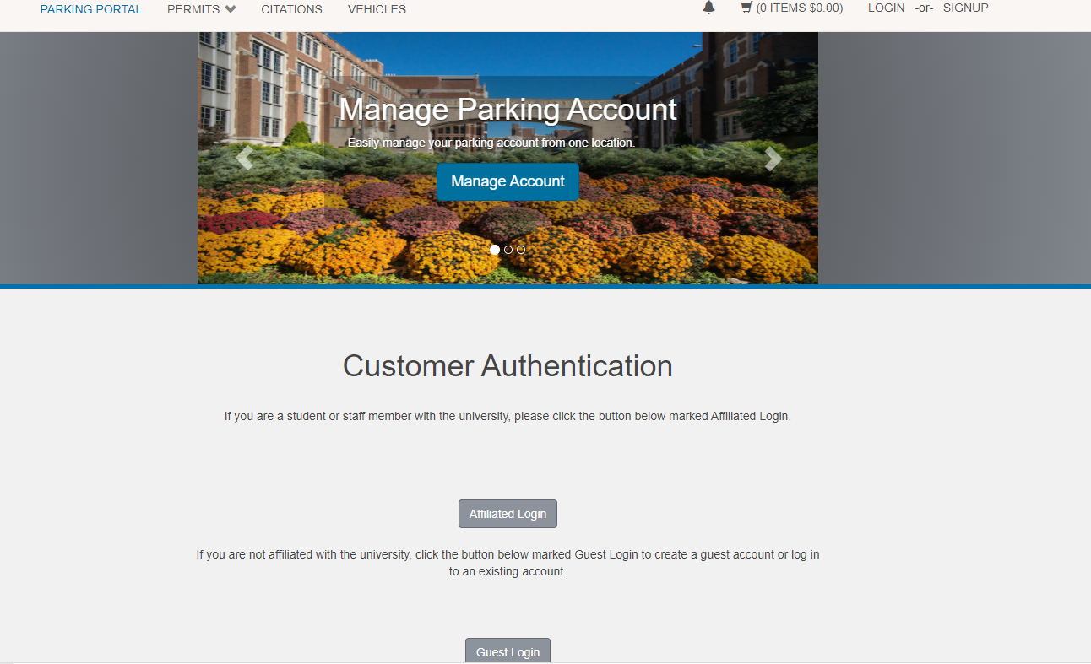
Signing In
Sign into the Parking Portal
  Click on affiliated Login button
Click Here

Slide 4
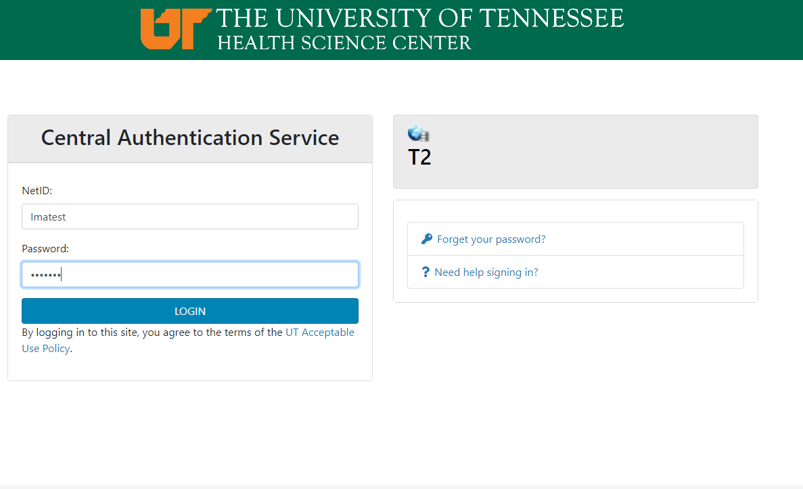
Signing In
Enter your credentials and password into the Central Authentication Service
Click Here

Slide 5
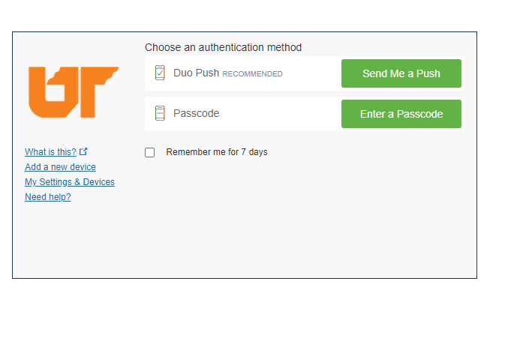
Signing In
Choose and click on your choice for authentication
  Follow the authentication process and you will be entered into the parking portal
Click Here

Slide 6
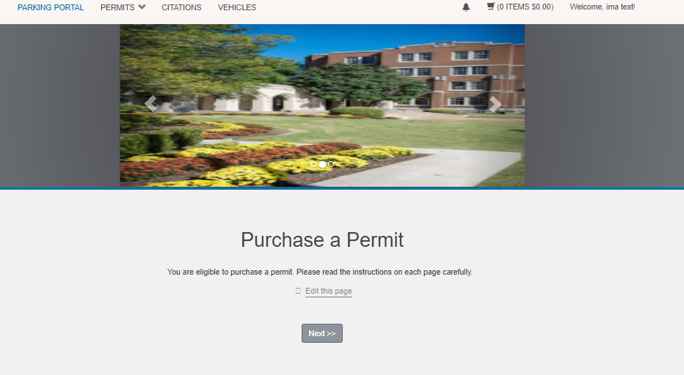
What can you do in the Parking Portal
Click on the Parking Portal Menu
Click Here
Click Here

Slide 7
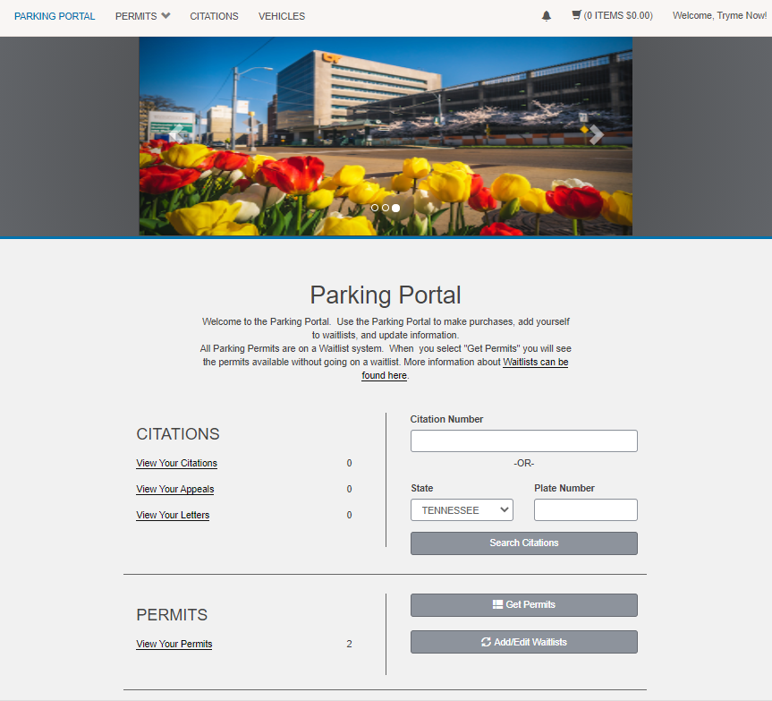
The Home Page
Please See Separate Videos for Purchasing Permits

Slide 8
The Home Page
Shows your’re signed in
Search for citations if you know the number
Search for citations by plate #
Purchase Permits
Add yourself to a wait list/view waitlist status

Slide 9
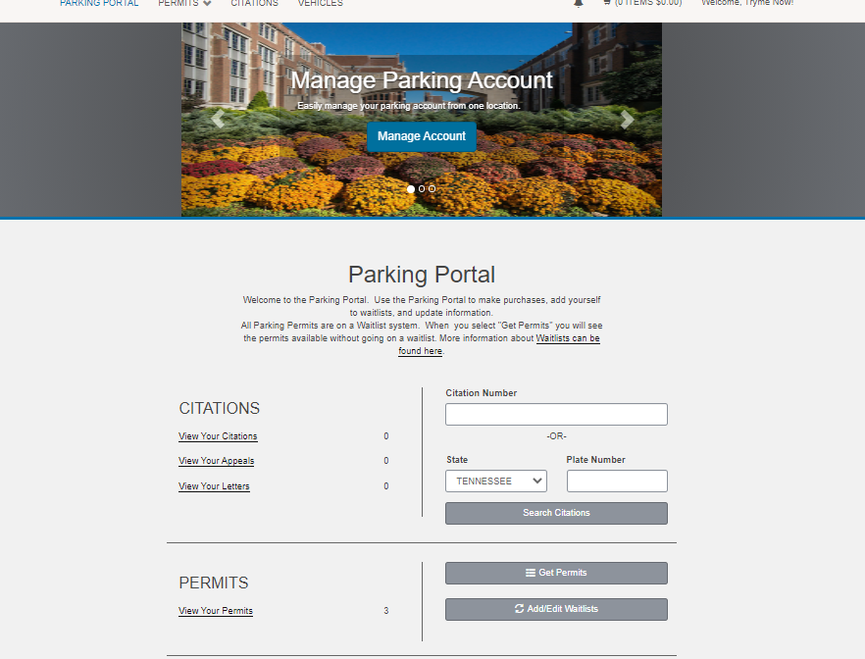
Update Account Information
Click Manage Account to bring up your account info
Update acct info here

Slide 10
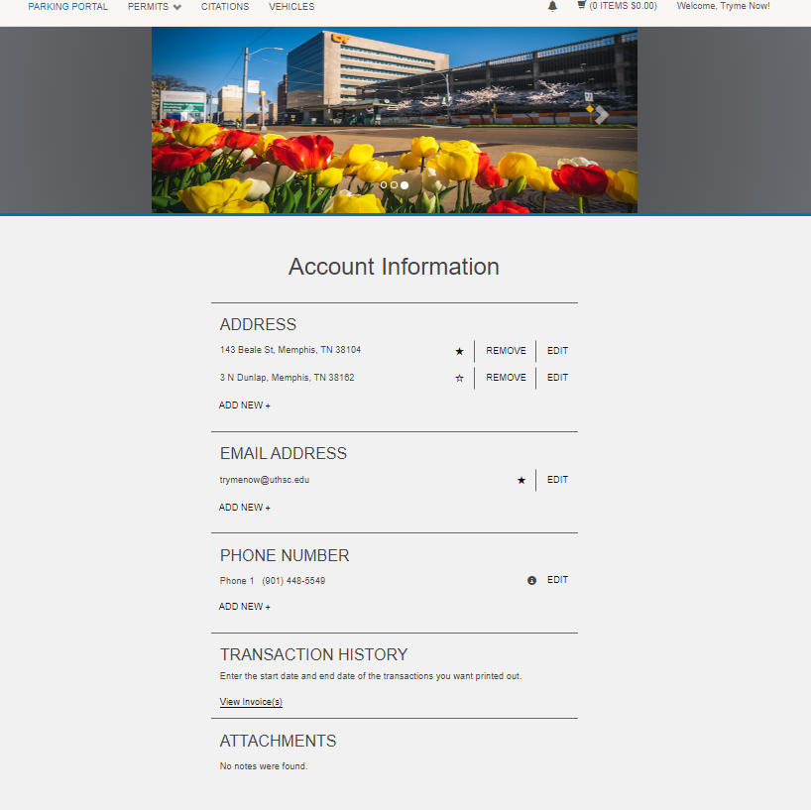
Update Account Information
Edit your account info by clicking on edit
Remove account info by clicking on remove (you cannot remove the last entry of any area)
Transaction History, and Attachments aren’t areas that need to be populated or used.

Slide 11
Update Vehicle Information
Click here to update vehicles
Click at Vehicles at top of screen

Slide 12
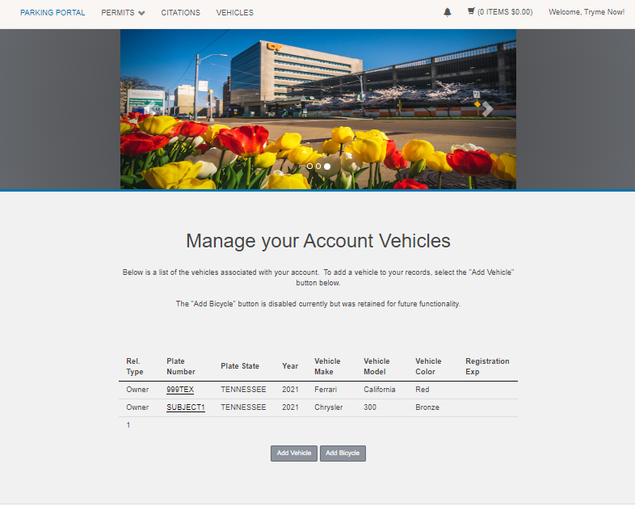
Update Vehicle Information
Click add a vehicle to add a new vehicle
If you need to remove a vehicle contact the parking office either by phone or email.
Bicycles are not used presently but saved for later utilization. Button will generate another screen saying it doesn’t work.

Slide 13
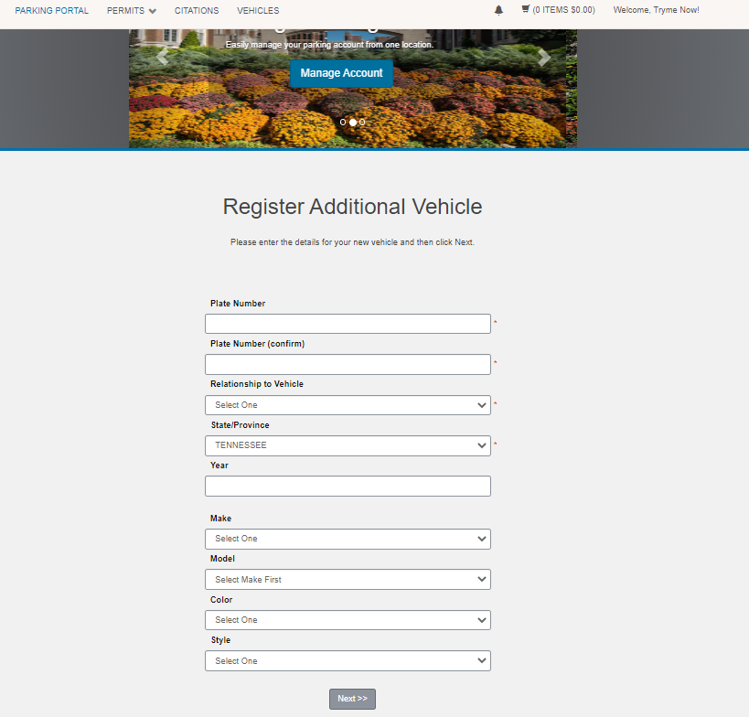
Update Vehicle Information
Enter or select information requested .
  Plate Number should have no spaces
  Relationship to vehicle is
  Driver – you don’t own the vehicle but use it.
    Owner – you own and drive the vehicle.
  State your plates are from
  Year vehicle was made
  Make – Toyota, Chevrolet, mazda, etc
  Model – Camry, Camaro, MX5, etc
  Color – red, yellow, purple, etc
  Style – four door, truck, suv, two door
  Once completed select next

Slide 14
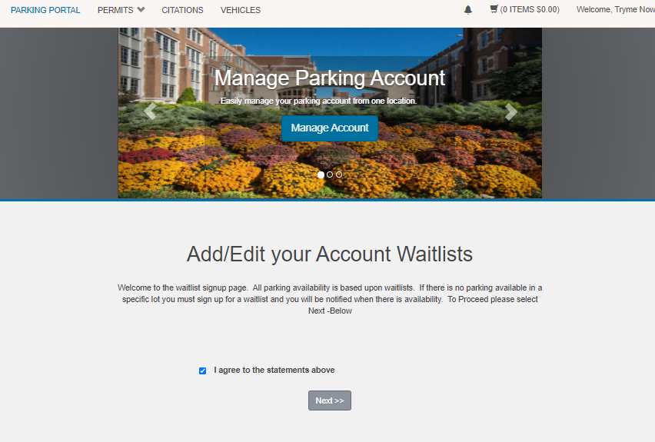
Add Yourself to a Waitlist/Check Waitlist Status
Agree to the waitlist conditions and click next
Click Here

Slide 15
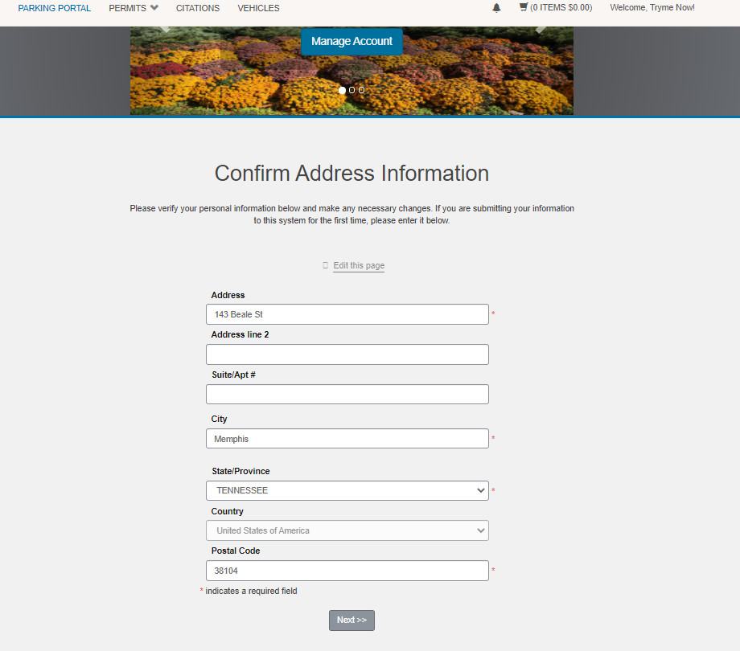
Add Yourself to a Waitlist/Check Waitlist Status
Confirm/update your address
Click Next
Click Here

Slide 16
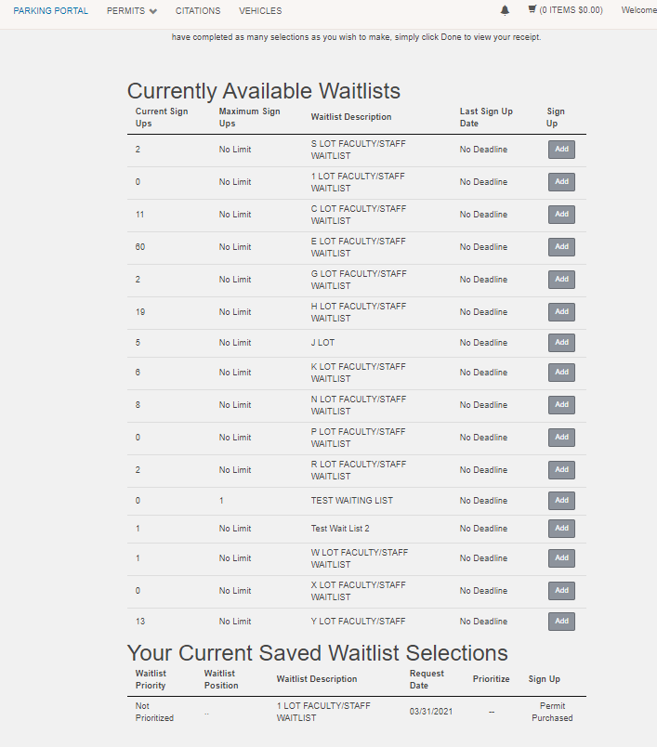
Add Yourself to a Waitlist/Check Waitlist Status
Click Add on the Waitlist you want to be added to
  We will select E Lot Waitlist
  After we are added it will add it to the current saved waitlist selections
Click Here

Slide 17
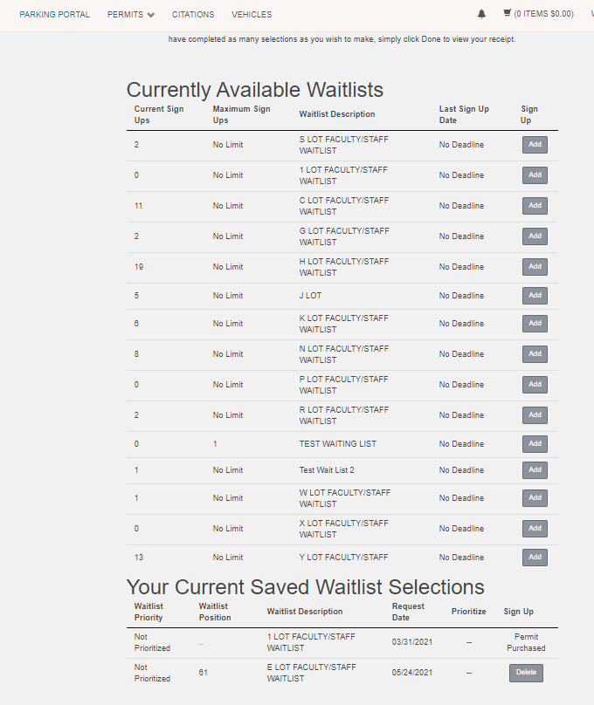
Add Yourself to a Waitlist/Check Waitlist Status
You can see you have been added
You can also see your position on the waitlist
Click delete button to remove yourself
You are now on the E Lot waitlist and 61st on the list

Slide 18
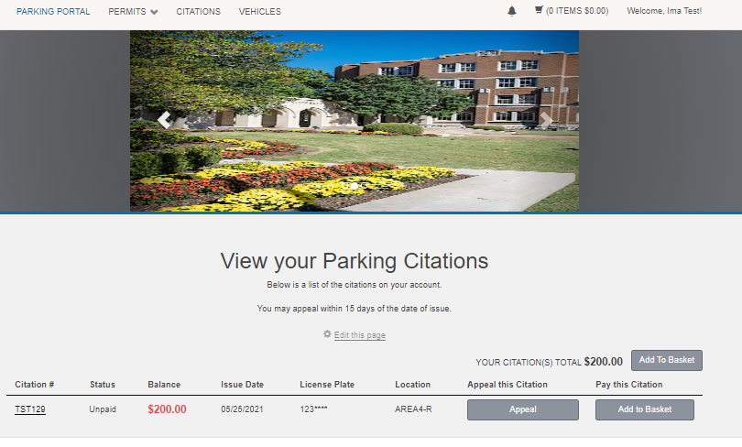
Citations – View/Pay/Appeal
From the citations page you can appeal, pay and review the citations on your account
Click citations to see list below

Slide 19
Citations – View/Pay/Appeal
To pay click add to basket
Then click on the shopping cart on the upper right and select pay now from the drop down.
That will take you to the payment page for payment by a credit card

Slide 20
Citations – View/Pay/Appeal
To appeal click on appeal
It will then ask for your plate number (from your vehicle or citation)

Slide 21
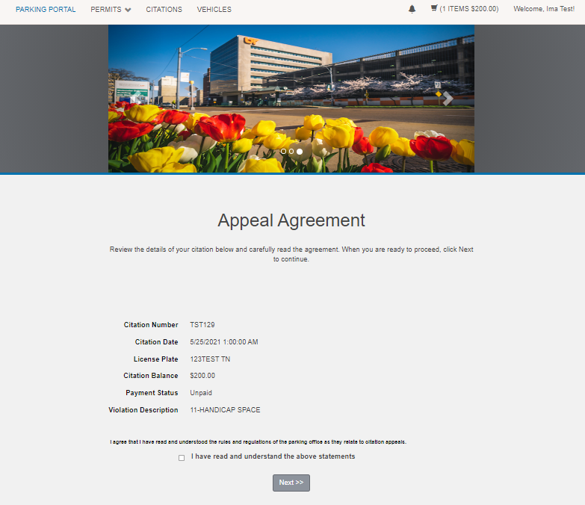
Citations – View/Pay/Appeal
Agree to the statements above
Click next

Slide 22
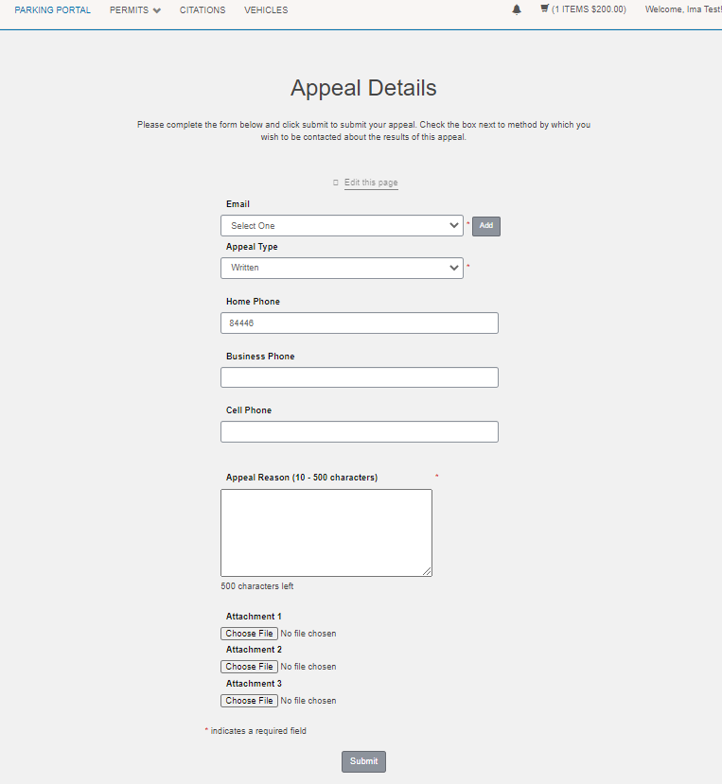
Citations – View/Pay/Appeal
Complete the fields in the page by selecting on the drop down or entering information
You may attach documents or pictures in the 3 spaces below.

Slide 23
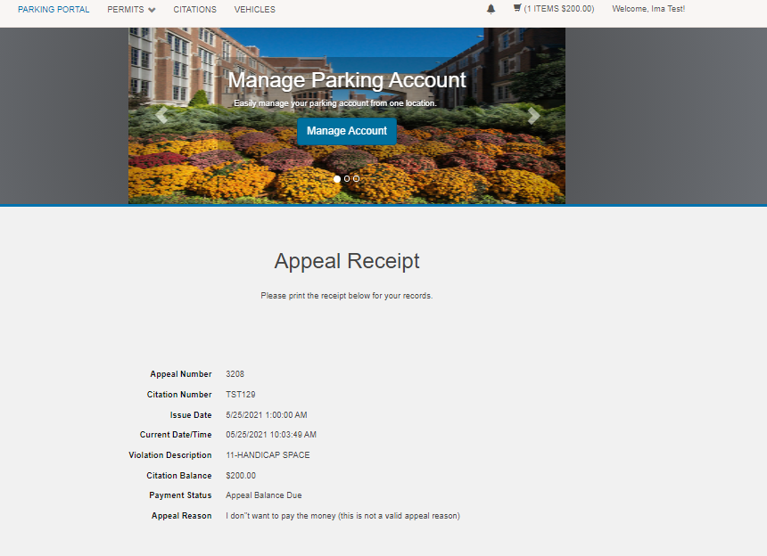
Citations – View/Pay/Appeal
Your appeal is submitted.
Upon a decision you will be notified by email.

Slide 24
Thanks for watching if you have questions please contact us:
UTHSC Parking Services
3 N. Dunlap Street
Memphis, TN 38163
Phone: 901.448.5549
Email: parkingservices@uthsc.edu

