Slide 1
Internal Audit Overview
UTHSC Business Managers’ Meeting
Amy Wilegus
July 2018

Slide 2
Agenda
Introductions
Internal Audit Overview
Internal Controls Discussion

Slide 3
Introductions
Luanne Gillock, CPA, CIA, CFE
Auditor II
First week with UTHSC
Over 20 years of internal audit experience, including healthcare auditing at Baptist and St. Jude
Taylor Ansel
Audit Intern
Senior, Rhodes College
Business & Spanish Majors with Concentration in Accounting
Summer & Fall 2018

Slide 4
Office of Audit & Compliance
Sandy Jansen,
CIA, CCSA, CRMA
Chief Audit and Compliance Officer
Amy Wilegus,
CPA, CISA, CISSP, CRISC
Audit Director
West Tennessee
Taylor Ansel
Audit Intern
Bobby Bruce,
CA
Auditor II
Luanne Gillock,
CPA, CIA, CFE
Auditor II
Amy Wilegus
901-448-1435 awilegus@uthsc.edu
Luanne Gillock
901-448-5572
Bobby Bruce
731-881-3100
bbruce10@utm.edu

Slide 5
Audit Planning
IIA Auditing Standards require annual risk assessment, audit plan development and independent approval
Obtain input from senior leaders on key risks
Develop risk-based audit plan
Obtain UT Audit Committee approval of audit plan
Notes:
Training budget cuts – staff responsible for their own development

Slide 6
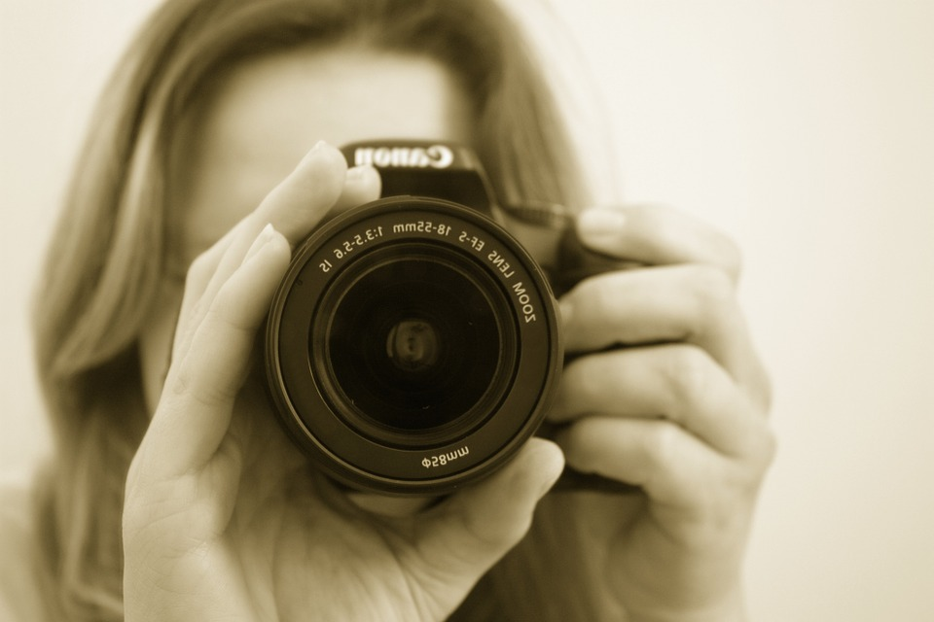
2018 Audit Plan
Department audits
Key areas in scope:
  Equipment inventory
  Department ledgers

Slide 7

Equipment Verification
Verify
Item description
Location
Tag number
Serial number
FI0605-Equipment
Policies
FI0600-SME
FI0610-Surplus Property
FI0131-Property Losses
FI0130-Fraud, Waste & Abuse
Changes were submitted timely

Slide 8
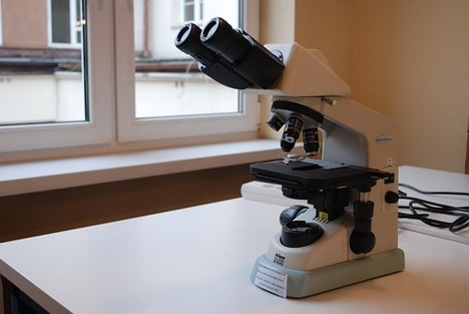
Common Discrepancies
Faculty taking equipment with them to new university
  May 2018 Bottom Line newsletter (Policy F10605 - Equipment, Section - Disposal 18G - Removal of Equipment Purchased with Grant or Contract Funds)
  Requires CBO approval, letter of acceptance from acquiring university, & Form T-64.
Missing tag number
Incorrect serial number

Slide 9
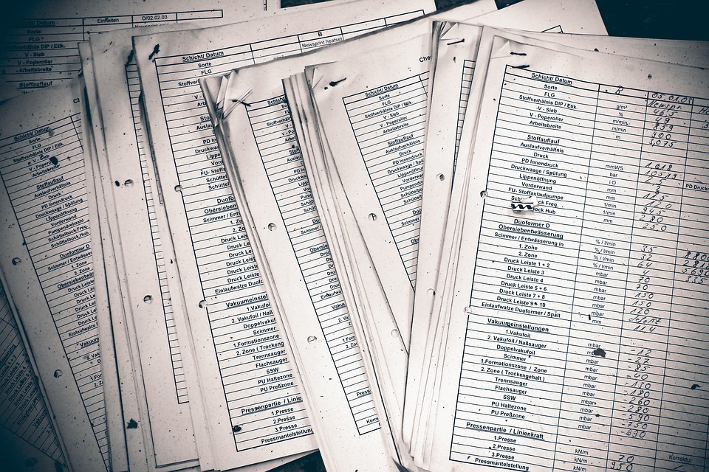
Department Ledgers
Required monthly review and approval
Policies:
  FI0110 (fiscal & budgetary management)
  FI0115 (ledger reconciliation)
  FI0150 (approvals)

