Slide 1
UTRF Institutional Revenue Sharing
Richard Magid
UTRF Vice President
March 2020

Slide 2
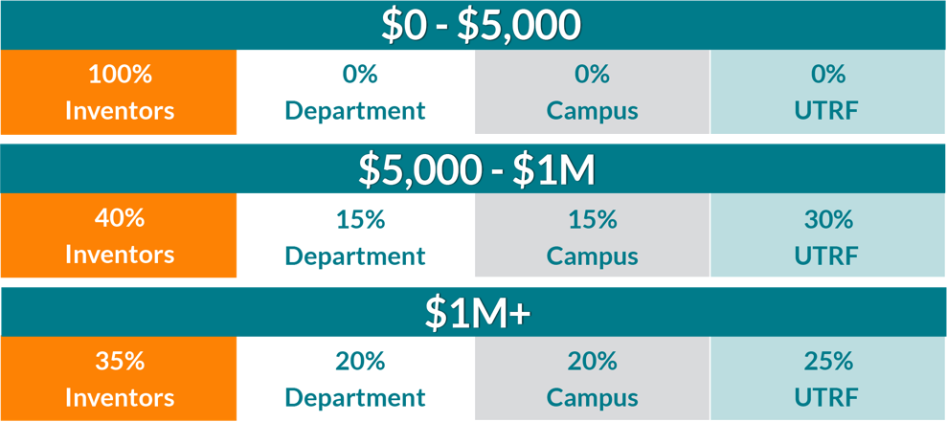
UTRF IP & REVENUE SHARING POLICIES
Intellectual Property Policy: Inventions made by UT employees in the course of their duties or using UT resources and facilities are owned by UT and assigned to UTRF.
Revenue Sharing Policy
Note: After the first $5,000, distributions are made on net revenues remaining after legal fees have been deducted.

Slide 3
Royalty Distributions
Individuals
UTRF sends checks directly to each inventor.
These are not UT salary or benefits, UTRF sends a separate 1099 each tax year.
  Individuals responsible for all tax liability
Departments
UTRF sends checks to Business Manager with an explanatory cover letter.
Department Head receives copy of cover letter.
Deans also receive a copy of cover letter (new SOP).
Campus
UTRF sends checks to Chancellor’s office with an explanatory cover letter.

Slide 4
Royalty Q&A
“What can Department/Campus royalties be used for?”
  A: Institutional royalties are basically unrestricted funds for use by the recipient unit. “Royalties… will be utilized for the support of scientific research or education;” 37 CFR 401.14(k)3
  “Do we have to report back to UTRF how the funds are used?”
  A: No, UTRF does not need a report on how the funds are used by the Department or Campus.
“Does UTRF know how much my unit will receive next year?”
A: It depends. Some UTRF licenses have fixed fees (predictable), while others generate royalties based on sales or milestones (unpredictable).
“Dr X left UTHSC, does s/he still receive royalties?”
A: Yes. Royalties are vested at the time of invention, and the inventor(s) will receive their share whether or not they remain at UTHSC.

