Slide 1
Financial Aid
College of Medicine

Slide 2
Applying for Financial Aid
FAFSA Application:
  www.fafsa.ed.gov (UTHSC School code: 006725)
FAFSA Opens - each school year (October 1st)

Slide 3
2018-19 Interest rate
Direct Unsubsidized Loans | Graduate or Professional | 6.6%
Direct PLUS Loans | Graduate or Professional Students | 7.6%
All interest rates shown in the chart above are fixed rates that will not change for the life of the loan.

Slide 4
Steps To Complete
ACCEPT AWARD
ENTRANCE COUNSELING
MASTER PROMISSORY NOTE
TUITION/FEES PAID
REFUND DISBURSED

Slide 5
Accept Award
To view your awards, follow these 5 steps:
Login to Banner Self-Service
Click on Financial Aid
Next, click on Award
Award for Aid year and select year
Accept the Terms and Conditions
Lastly, you should click on Accept Award Offer
*NOTE: When accepting awards, you are accepting for the entire year and not just for the term.

Slide 6
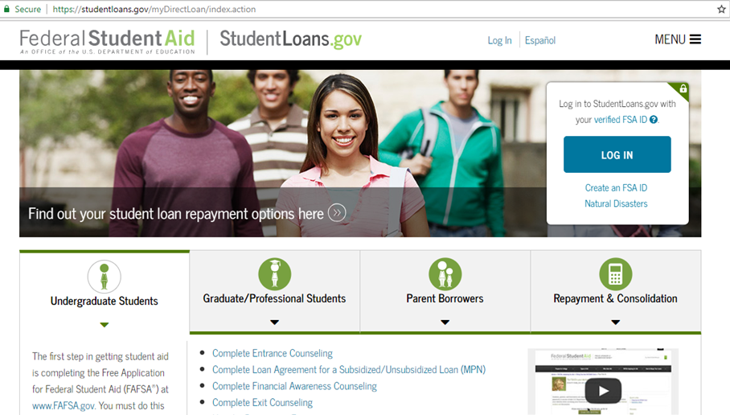
Entrance Counseling
Sign in to StudentLoans.gov using your Federal Student Aid PIN
  Select "Entrance Counseling"

Slide 7
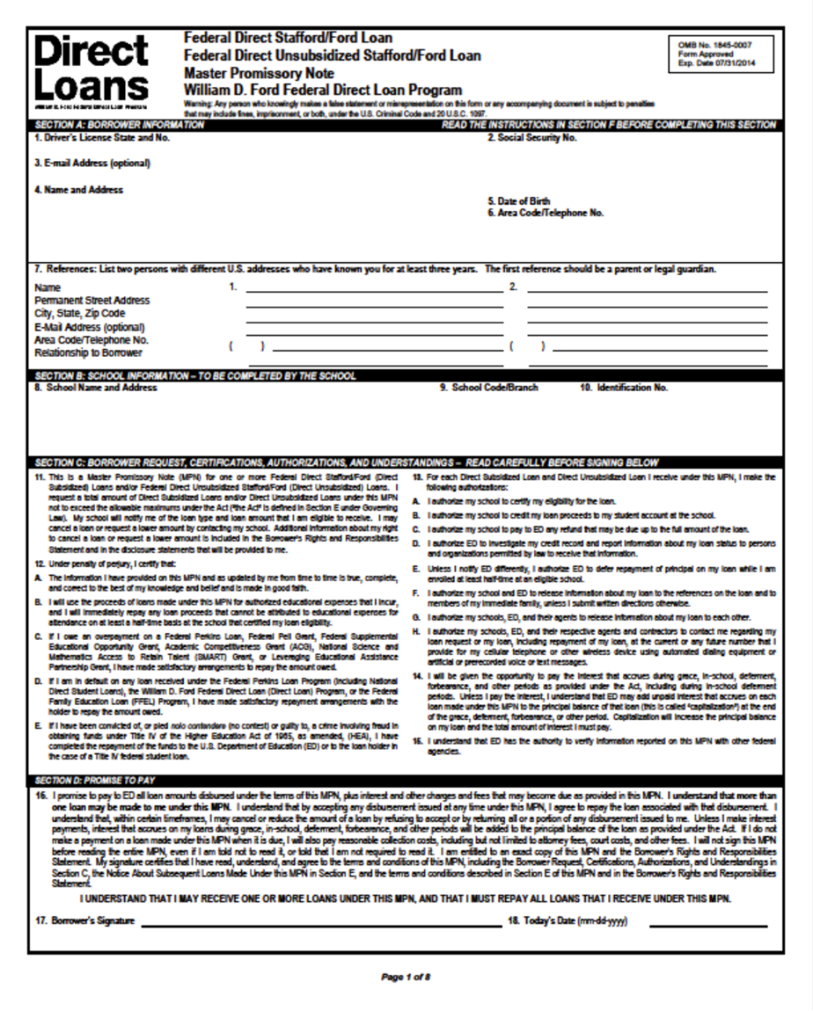
Master Promissory Note
(MPN)
Includes your rights and responsibilities as a borrower and it’s the legal document all student loan borrowers must complete promising to repay the loan.
Unsubsidized & Graduate Plus each year!

Slide 8
Banner Self-Service
Direct Deposit Refunds Setup for Students
Go to: Banner Self-Service
2. Enter Your Net ID and Password.
3. At the Main Menu, click on Student.
4. On the Student menu, click on Student Account.
5. Click on Account Summary.
6. Next, click on Pay Your Fees.
7. Click on eRefunds and follow instructions to set up account.

Slide 9

Refund Disbursement
Financial aid must first pay a student's tuition and fees each term. If excess funds remain after paying these expenses, the student is sent a financial aid refund to help them pay for their books and living expenses.
All refunds are direct deposited to your checking account or mail.

Slide 10
One On One Counseling
ALL M1 incoming students are required to schedule and complete a one-on-one counseling session with their Financial Aid Counselor.
Must complete counseling – Student will not be able to register for Spring 2019 term.
Office Visit
Phone
                MANDATORY!!!

Slide 11
Types of Loans
Direct Unsubsidized Loan
Direct Graduate Plus Loan
Private/Alternative Loan

Slide 12
Direct Unsubsidized Loan
$42,722 (Unsubsidized)
  6.60% Interest rate
  No payments while in school
  Interest accrual daily after disbursement
  Payments begin six months after graduation

Slide 13
Direct Graduate PLUS Loan
Eligibility is the difference between your Cost of Attendance (COA) Budget MINUS other aid being received
  7.60% interest rate
  No payments while in school
  Interest accrual daily after disbursement
  Payments begin six months after graduation
  Where to apply:
http://www.uthsc.edu/finaid/forms.php

Slide 14
Cost of Attendance

Slide 15
2018-2019
In-State Cost of Attendance
ESTIMATE
Tuition/Fees $35,006
Books and Supplies $ 1,750
Living Expenses $21,770
Total $58,526

Slide 16
2018-2019
Out-of-State Cost of Attendance
ESTIMATE
Tuition/Fees $68,098
Books and Supplies $ 1,750
Living Expenses $21,770
Total $91,618

Slide 17
In-state packaging example
COA = $58,526
$42,722 Direct Unsubsidized Loan
$15,804 Graduate PLUS Loan
$58,526
*Scholarships/Institutional waivers will decrease loan amounts

Slide 18
Out-of-state packaging example
COA = $91,618
$42,722 Direct Unsubsidized Loan
$48,896 Graduate PLUS Loan
$91,618
* Scholarships/Institutional waivers will decrease loan amounts

Slide 19
Budgeting

Slide 20
Create A Budget
A budget is a plan for your future income and expenses that you can use as a guideline for spending and saving.
A good monthly budget can help ensure you are borrowing only what you need while in-school.
http://uthsc.edu/financial-aid/flight/budgeting.php

Slide 21


Budgeting Apps
The market leader in budgeting management syncs with user accounts to track spending Free iOS, Android
Get started
The app automatically updates and categorizes transactions, creating a picture of spending in real time.
PocketGuard gives users a snapshot of how much they can spend at any given moment Free iOS, Android
Get started
It crunches the numbers to show how much money is available after accounting for bills, spending and savings goal contributions. All users can view how much money is left “in their pocket” for the day, week or month.

Slide 22
Credit Bureaus
Equifax www.equifax.com
1-800-525-6285
Experian www.experian.com
1-888-397-3742
Transunion www.transunion.com
1-800-680-7289
**Free credit report authorized by the Federal Trade Commission: www.annualcreditreport.com
www.CreditKarma.com

Slide 23
Student Loan History

Slide 24
Origination Fee
Origination fee - An amount, usually calculated as a percentage of a loan, which a lender charges for processing your application.
Loan Type | First Disbursement Date | Loan Fee
Direct Subsidized Loans and Direct Unsubsidized Loans | On or after 10/1/18 and before 10/1/19 | 1.062%
 | On or after 10/1/17 and before 10/1/18 | 1.066%
Direct PLUS Loans | On or after 10/1/18 and before 10/1/19 | 4.248%
 | On or after 10/1/17 and before 10/1/18 | 4.264%

Slide 25
Credit check with Graduate Plus Loan
Requires a credit check as part of the application process
You cannot have any adverse credit history - Obtain an endorser
Your credit is evaluated every time you request a new PLUS loan - after 180 days

Slide 26
NSLDS – Loan History
The National Student Loan Data System (NSLDS) is the U.S. Department of Education's (ED's) central database for student aid. NSLDS receives data from schools, guaranty agencies, the Direct Loan program, and other Department of ED programs. NSLDS Student Access provides a centralized, integrated view of Title IV loans and grants so that recipients of Title IV Aid can access and inquire about their Title IV loans and/or grant data.

Slide 27
Nslds.ed.gov
View your federal student aid history
Get your loan servicer’s contact information
Download your federal student aid history into a text file using the MyData Download function
Establish an online account with Loan Servicing to track your loan history while school…

Slide 28
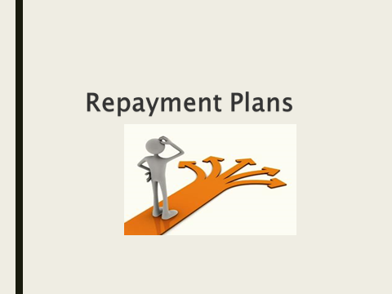

Slide 29

Understanding Repayment Plans
Student borrowers may repay their student loans through one of the several repayment plans:
Standard Repayment
Graduate Repayment
Income Base Repayment (IBR)
Pay As You Earn (PAYEE)

Slide 30
Standard Repayment Plan
Standard Repayment
Graduate Repayment
Income Base Repayment (IBR)
Pay As You Earn (PAYEE)
Under this plan, the borrower will pay a fixed amount of at least $50 each month for up to 10 years. For most borrowers, this plan results in the lowest total interest paid because the repayment period is shorter than it would be under any of the other repayment plans.
(Subsidized, Unsubsidized and PLUS Loans)

Slide 31
Graduated Repayment Plan
The Graduated Repayment Plan may be beneficial if the borrower’s income is low when they leave school but is likely to steadily increase. Under this plan, payments start out low and then increases every two years.
Like the Standard Plan, the maximum repayment period is 10 years for Subsidized, Unsubsidized, and PLUS Loans.
Standard Repayment
Graduate Repayment
Income Base Repayment (IBR)
Pay As You Earn (PAYEE)

Slide 32
Income-Based Repayment
Standard Repayment
Graduate Repayment
Income-Base Repayment (IBR)
Pay As You Earn (PAYEE)
  Under IBR, monthly payment is based on the borrower’s Adjusted Gross Income (AGI), family size, and state of residence.
Monthly payments are adjusted each year according to changes in your income and family size – new application must be submitted.
An IBR fact sheet, calculator and Q&A is available on www.StudentAid.ed.gov

Slide 33
PAYE – Pay As You Earn
Standard Repayment
Graduate Repayment
Income Base Repayment (IBR)
Pay As You Earn (PAYEE)
New borrower - no outstanding balance on a Direct Loan or FFEL Program of federal loans.
All undergraduate loans must be paid in full and cannot be consolidated

Slide 34
Postpone Payment
You can receive a forbearance that allows you to temporarily postpone or reduce your federal student loan payments. Postponing or reducing your payments may help you avoid default.
With forbearance, you may be able to stop making payments or reduce your monthly payment for up to 12 months.
Interest will continue to accrue on your subsidized and unsubsidized loans (including all PLUS loans).

Slide 35
Accrued Interest
Accrued interest is the amount of loan interest that is accruing while you are in-school, but has not yet been paid to the lender by the borrower.
Capitalization - adding unpaid, accumulated interest to the principal balance of your loan. Capitalization increases the total cost of your loan.

Slide 36
Public Service Loan Forgiveness
Program (PSLF)
Students can receive loan forgiveness through the Public Service Loan Forgiveness (PSLF) Program:
Must make on-time, full monthly payments under the Income-Contingent Repayment, Pay As You Earn (PAYE) or Income Base Repayment (IBR) plans while employed full-time in public service job
Must make 120 monthly payments that are required to receive loan forgiveness through the PSLF Program
Employed full-time (30 hrs.) with a non-profit 501(c)3 organization, government, military, or public service organization
For medical students, payments made during a full-time residency program can count toward your 120 required payments

Slide 37
One-Stop-Shop
Located in 910 Building on the 1st floor
Services available:
Financial Aid
Registrar Office
Admissions
Residency

Slide 38
Resources:
Financial Literacy Newsletter:
FLIGHT News
Financial Literacy Website
http://www.uthsc.edu/finaid/flight/index.php
Facebook Page:
UTHSC Flight
Financial Literacy Library:
    (located in the One-Stop)

Slide 39

Questions & Answers

Slide 40
Contact Information
Ms. Janice G. Maddox, MBA
Coordinator, Financial Literacy
One Stop Shop
(901) 448-1601
jmaddox9@uthsc.edu
Skype: Janice.maddox3

