Slide 1
Engagement Action Planning
Manager Toolkit

Slide 2

Instructions for HR
This toolkit includes guides and templates for managers to interpret and act on their employee engagement survey results. You can remove, customize, and distribute specific guides within this toolkit or provide the toolkit in its entirety.
Slide 3
Interpreting the Manager Scorecard – Manager Guide
Interpreting the Department Scorecard – Manager Guide
Slide 15
Slide 26
Engagement Results – Debrief Template
Slide 35
Team Engagement Activities – Manager Guide
Delete this slide before distributing.

Slide 3

Interpreting the Manager Scorecard – Manager Guide

Slide 4
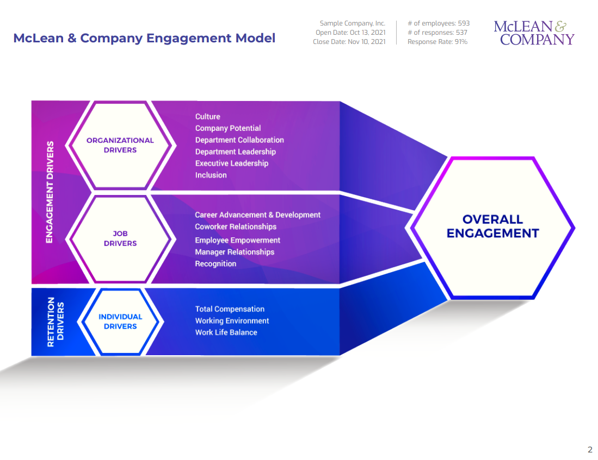
Analyze your results and identify strengths, weaknesses, and focus areas for team discussions
First, analyze overall engagement levels, then look at driver scores, and lastly, individual questions to get an informed picture of engagement in your team.
1
Engagement levels
2
Driver scores
Engagement Drivers
3
Question scores
Retention Drivers

Slide 5

Start interpreting your engagement results by analyzing your team’s overall engagement levels
1
Reviewing your team’s overall engagement results is the first step in determining how engaged your team is:
Identify how engaged your team is relative to the whole organization’s engagement by comparing your team’s and the organization’s results.
Review your Employee Experience Monitor score and how it compares to the organizational average.
Notice how engagement has trended from the previous year (if applicable).

Slide 6
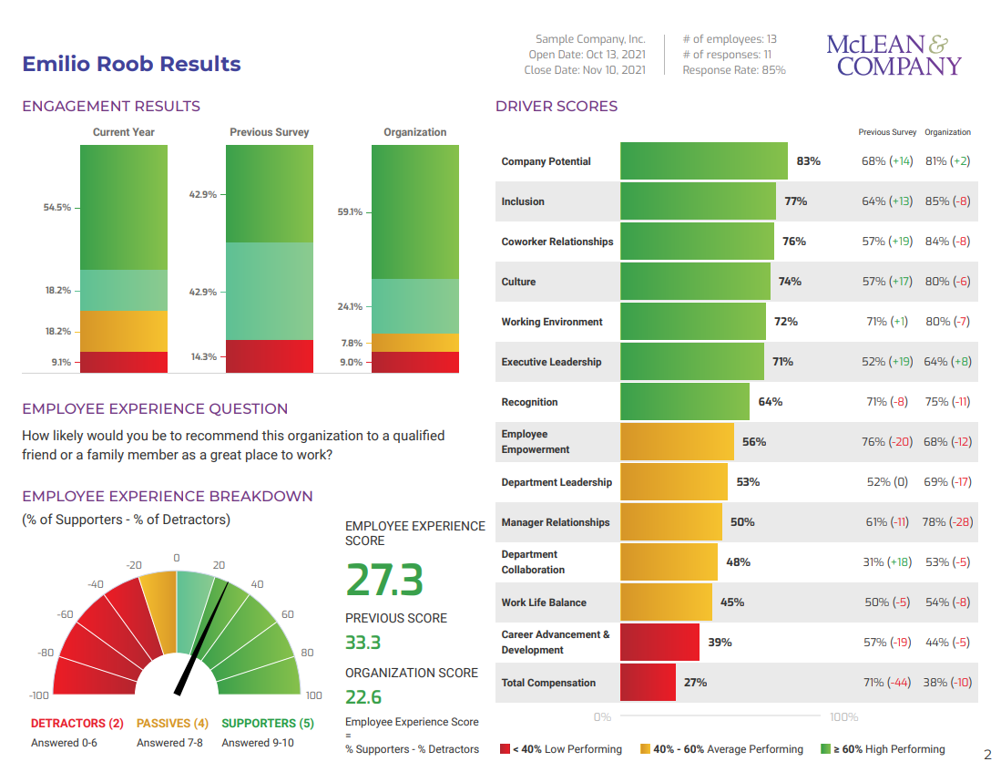
Engagement Levels

Slide 7
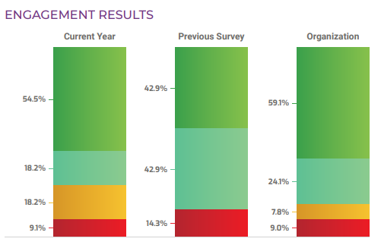
1
The four levels of engagement
Engaged: Employees are organization ambassadors: they have a sense of ownership, passion, purpose, and pride in the organization.
Almost engaged: Employees feels a sense of satisfaction and commitment to the organization and are often motivated to go the extra mile.
Indifferent: Satisfied employees that do not feel a sense of purpose or pride in their work – it’s “just a job.”
Puts in time to meet minimum requirements.
Disengaged. May not openly show dissatisfaction, but their attitude is negative, affecting work and peers.
Does not meet requirements.
Appears “checked out.” Complains often.

Slide 8
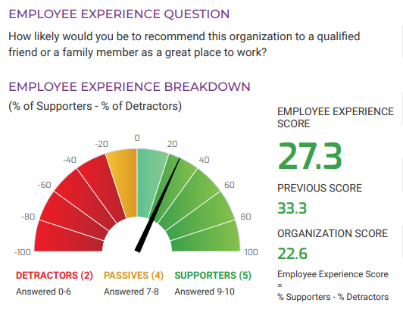
McLean Employee Experience Monitor
1
The Employee Experience Monitor is a single question that delivers powerful feedback correlated to employee engagement.
Your Team’s Employee Experience Score
Supporters – Detractors = Employee Experience Score
Organization
Employee Experience Score
Supporters – Detractors = Employee Experience Score
(N= 141683 , 157 companies)

Slide 9
Review driver scores to identify your team’s strengths and weaknesses
2
There are ten engagement drivers and four retention drivers. Each driver’s score is calculated by averaging the scores for questions grouped under that driver.
Examining driver scores will help determine which areas you should leverage and where you need to make improvements.
What are the top three highest- and lowest-scoring drivers? Is this list similar to the top highest- and lowest-scoring drivers for the department?
When you compare the department score for each driver versus your team’s score for each driver, what three drivers have the largest positive difference and the largest negative difference?
Those drivers with scores low relative to other drivers, and that have a large negative gap between your team’s score and the department score, are your priority.
Ask yourself “What’s important to employees’ engagement?” While you likely don’t have this statistical analysis for your team, you may have it for your department, and you should have it for the entire organization. This analysis is presented in the McLean & Company prioritization matrix.

Slide 10
Driver Scores
2

Slide 11

Analyze the results for each statement within the drivers
3
In analyzing specific engagement drivers, look at how individual questions were answered.
Questions are presented as statements. For example, “I trust my leader.”
Respondents indicate their level of agreement to a statement by selecting one of six points on the scale.
Each question then receives a top-box score – the percentage of employees who scored it five or six. For example, if the question “I trust my leader” has a score of 40%, 40% of employees agreed or strongly agreed with this statement.
1= Strongly Disagree
6= Strongly Agree
1 2 3 4 5 6
Bottom Box
Top Box

Slide 12
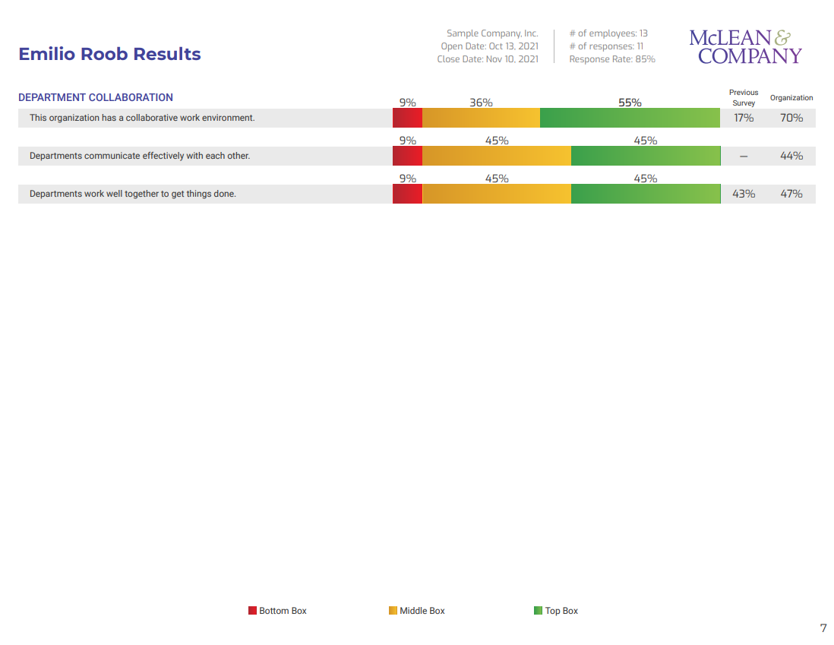
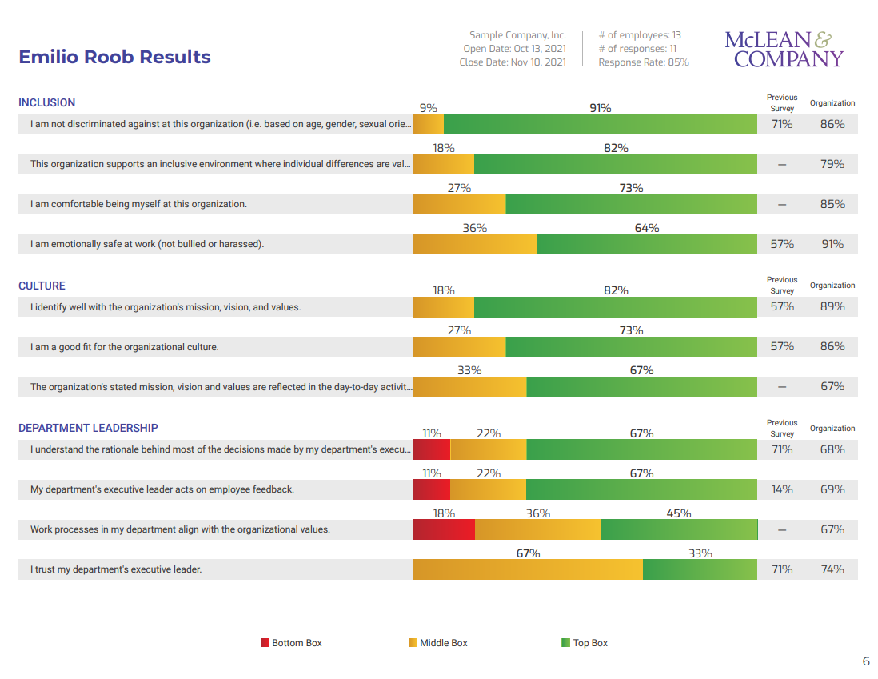
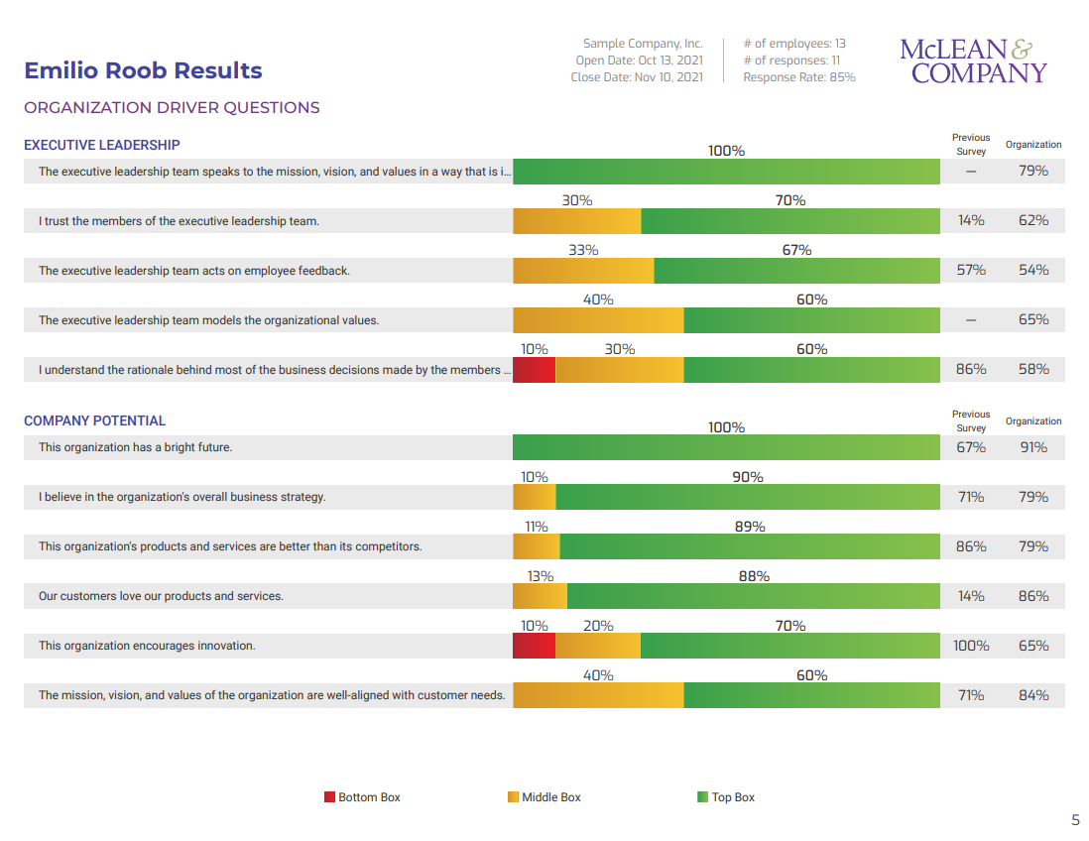
Statement Top Box Scores

Slide 13
Don’t let your reaction color your next steps!
Whether positive or negative, your next steps present an opportunity for growth and improvement.
If you have strong results:
Find out what’s working so that you can keep doing it.
Remember that there is always room for improvement, and as a manager, you should be constantly looking for opportunities to continue engaging your team.
If you are new to the team and are faced with interpreting and acting on your predecessor’s results:
Use the results as an opportunity to build your relationship with the team.
Don’t fall into the trap of thinking the results are irrelevant or that they can be ignored. It’s your starting point.
  If you have poor results:
  Interpret your results as objectively and impartially as possible. Take some time to cool down if needed.
  While you may not agree with the results, it is the perception of those who work for you. Perception is the reality here.
  Even if there are circumstances outside of your control, you can still make improvements in how you deal with them.
  Step back from the results and understand that this is a starting point to make things better – not a medium to criticize. Look at it as a development opportunity.

Slide 14


Slide 15
Interpreting the Department Scorecard – Manager Guide

Slide 16
Analyze your results and identify strengths, weaknesses, and focus areas for team discussions
First analyze overall engagement levels, then look at driver scores, and lastly, individual questions to get an informed picture of engagement in your team.
1
Engagement levels
2
Driver scores
Engagement Drivers
3
Question scores
Retention Drivers

Slide 17
Start interpreting your engagement results by analyzing your department’s overall engagement levels
1
Reviewing your team’s overall engagement results is the first step in determining how engaged your team is:
Identify how engaged your team is relative to the whole organization’s engagement by comparing your team’s and the organization’s results.
Review your Employee Experience Monitor score and how it compares to the organizational average.
Notice how engagement has trended from the previous year (if applicable).

Slide 18
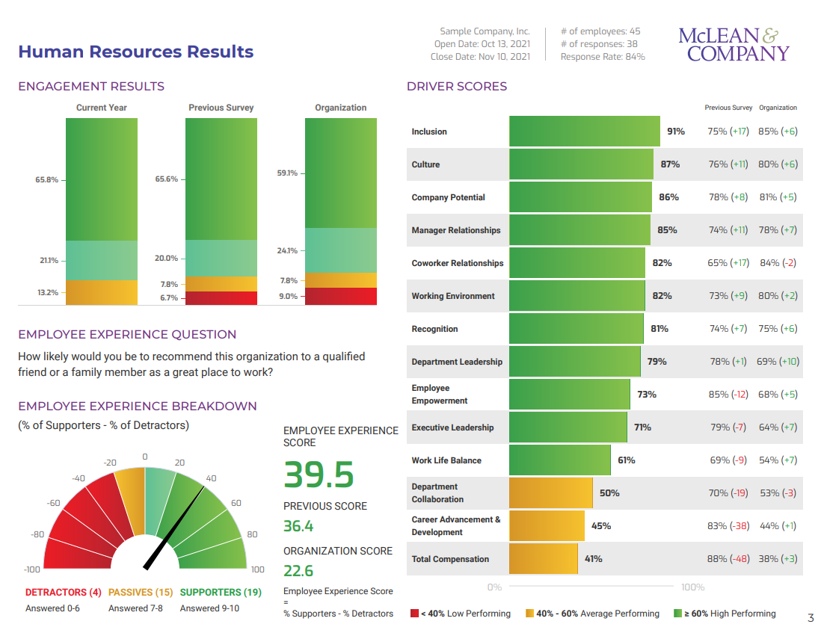
Engagement Levels

Slide 19
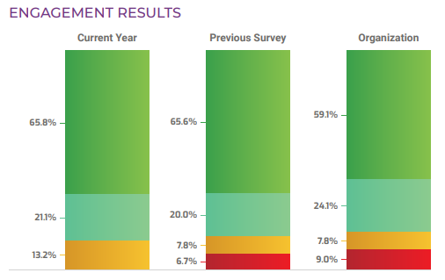
1
The four levels of engagement
Engaged: Employees are organization ambassadors: they have a sense of ownership, passion, purpose, and pride in the organization.
Almost engaged: Employees feels a sense of satisfaction and commitment to the organization and are often motivated to go the extra mile.
Indifferent: Satisfied employees that do not feel a sense of purpose or pride in their work – it’s “just a job.”
Puts in time to meet minimum requirements.
Disengaged. May not openly show dissatisfaction, but their attitude is negative, affecting work and peers.
Does not meet requirements.
Appears “checked out.” Complains often.

Slide 20
McLean Employee Experience Monitor
1
The Employee Experience Monitor is a single question that delivers powerful feedback correlated to employee engagement.
Your Team’s Employee Experience Score
Supporters – Detractors = Employee Experience Score
Organization
Employee Experience Score
Supporters – Detractors = Employee Experience Score
(N= 141683 , 157 companies)

Slide 21
Review driver scores to identify strengths and weaknesses
2
There are ten engagement drivers and four retention drivers. Each driver’s score is calculated by averaging the scores for questions grouped under that driver.
Examining driver scores will help determine which areas you should leverage and where you need to make improvements.
What are the top three highest- and lowest-scoring drivers? Is this list similar to the top highest- and lowest-scoring drivers for the organization?
When you compare the organization score for each driver versus your department’s score for each driver, what three drivers have the largest positive difference and the largest negative difference?
Those drivers with scores low relative to other drivers, and that have a large negative gap between your department’s score and the organization score, are your priority.
Ask yourself “What’s important to employees’ engagement?” Run a Priority Matrix for your department using the McLean Connect Dashboard to determine what drivers have the biggest impact on your employees’ engagement.

Slide 22
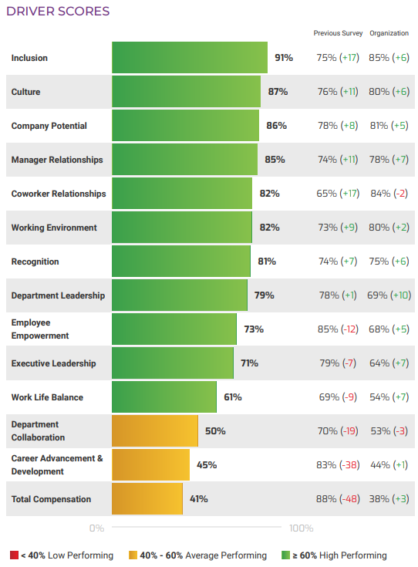
Driver Scores
2
The overall driver score is the average score of all the statements within that driver.

Slide 23
Analyze the results for each statement within the drivers
3
In analyzing specific engagement drivers, look at how individual questions were answered.
Questions are presented as statements. For example, “I trust my leader.”
Respondents indicate their level of agreement to a statement by selecting one of six points on the scale.
Each question then receives a top-box score – the percentage of employees who scored it five or six. For example, if the question “I trust my leader” has a score of 40%, 40% of employees agreed or strongly agreed with this statement.
1= Strongly Disagree
6= Strongly Agree
1 2 3 4 5 6
Bottom Box
Top Box

Slide 24
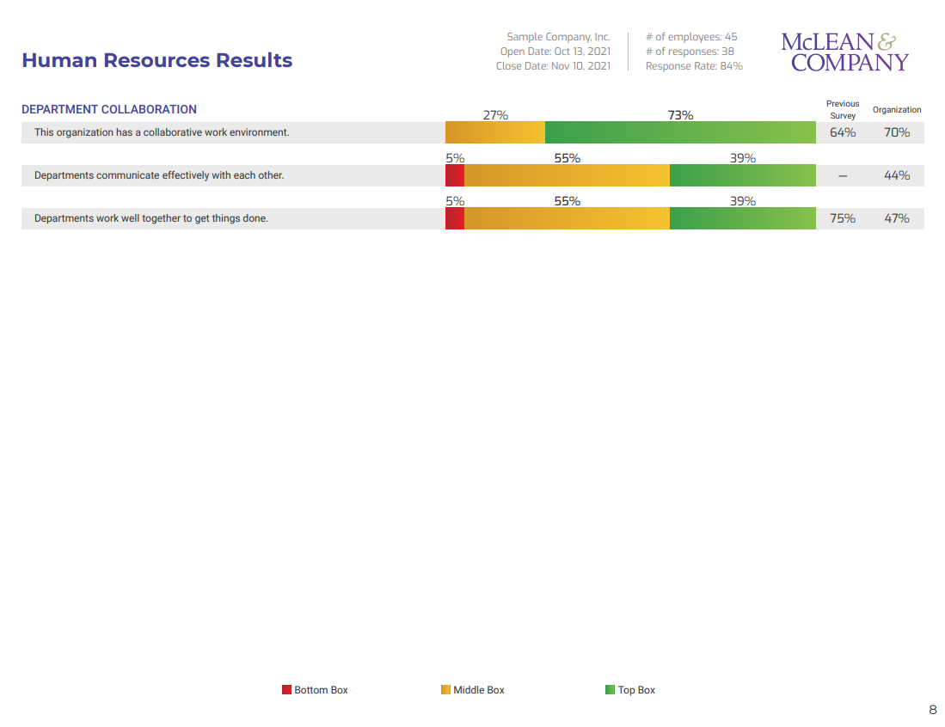
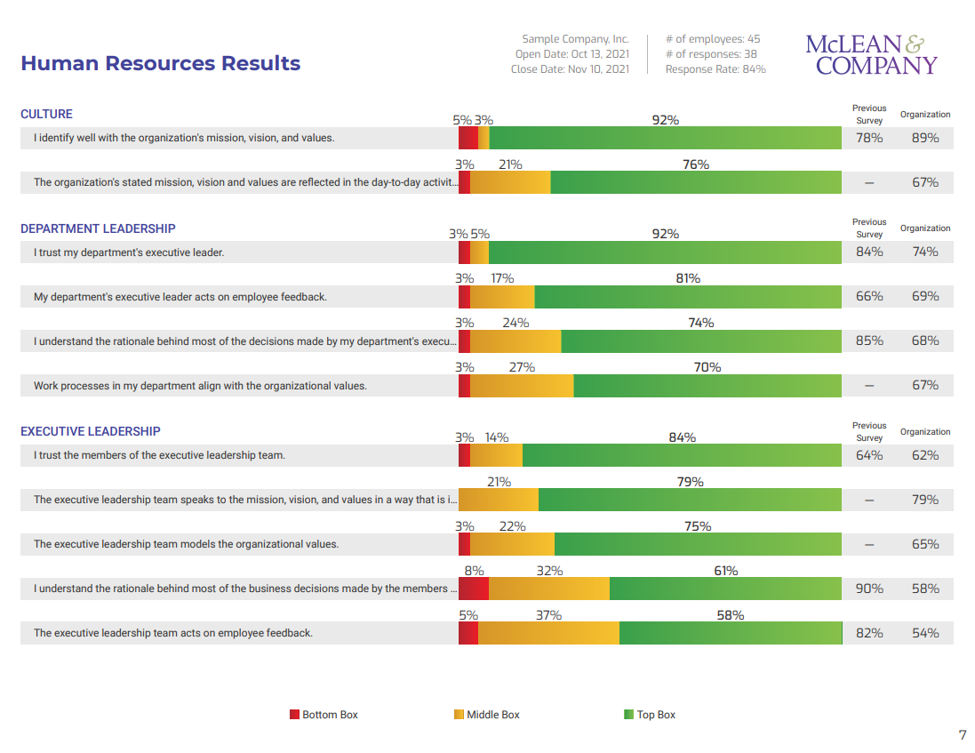
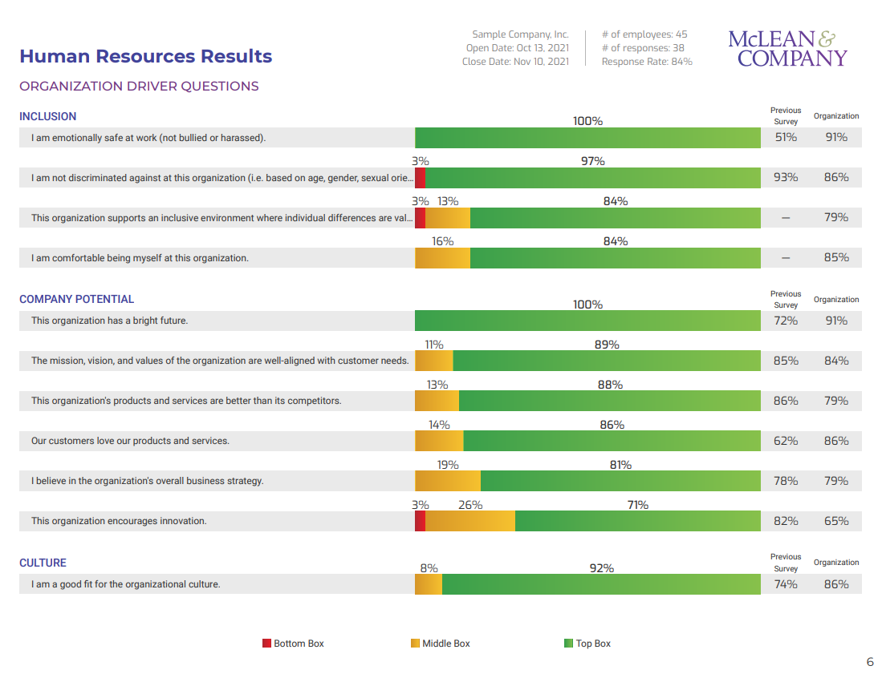
Statement Top Box Scores

Slide 25


Slide 26

[year]
Engagement Results
[Insert team name]
Look for these icons to guide customization of this document (delete the box before use).
Edit or replace with the engagement results for your organization.
Notes:
Facilitator Notes:
This template can be used by a manager to communicate team engagement survey results. There are detailed instructions on each slide for customization. Delete and modify the content to fit your team’s needs where you see the pencil icon.
Here are some tips to help you get started:
Start with a general overview of the results (this includes participation, team engagement levels, EXM, and overall driver results), then dive deeper into the results driver by driver.
Identify the top three highest-scoring drivers and the three lowest-scoring drivers.
Include any patterns or trends you’ve noticed during your initial analysis.
If possible, include comparisons to previous year’s results.
Compare how your team is performing to the overall organizational average.
Be transparent – share the good and the bad.
Keep the language neutral – refrain from using overly dramatic adjectives (e.g. “We did abysmally on...”) or attributing the scores to employees (e.g. “You rated us very highly on…”).
Be positive – acknowledge strengths and present lower-scoring areas as opportunities for improvement.
Avoid interpreting the results – stick to the scores unless there is additional contextual information that may have impacted the organizational results (e.g. layoffs due to an economic downturn).

Slide 27

Meeting agenda
1
What Is Engagement?
2
Engagement Survey Results
3
Next Steps
Notes:
Speaker’s Notes:
Today we review the results of our engagement survey.
This is the agenda we will be following for the session.
First, we’ll talk about what we mean by “engagement.” Then, we will review our team’s results in detail. Finally, we will talk about next steps.

Slide 28
What is engagement and how is it measured?
Engaged employees feel energized, passionate, and dedicated. They are highly involved with their work and the organization.
Organizational engagement drivers are areas that influence an employee’s satisfaction and commitment to their organization.
Job engagement drivers are areas that influence an employee’s satisfaction and commitment with their day-to-day role.
Retention drivers are areas that influence an employee’s desire and likelihood to stay at an organization.
Notes:
Speaker’s Notes:
McLean & Company’s engagement survey includes questions to determine an employee’s engagement level. Engaged employees feel energized, passionate, and dedicated. They are highly involved with their work and the organization.
The remaining questions measure an employee’s perception of drivers of engagement.
Organizational engagement drivers are areas that influence an employee’s satisfaction and commitment to their organization.
Job engagement drivers are areas that influence an employee’s satisfaction and commitment with their day-to-day role.
Retention drivers are areas that influence an employee’s desire and likelihood to stay at an organization.

Slide 29
Overall engagement levels
Notes:
Facilitator Notes:
The following three slides are template slides and speaker’s notes that align to the results in the Manager Scorecard. Customize the slides based on what you want to share. Some general tips:
Include any patterns or trends you’ve noticed during your initial analysis.
If possible, include comparisons to previous year’s results.
Compare how your team is performing to the overall organizational average.
Be transparent – share the good and the bad.
Keep the language neutral – refrain from using overly dramatic adjectives (e.g. “We did abysmally on...”) or attributing the scores to employees (e.g. “You rated us very highly on…”).
Be positive – acknowledge strengths and present lower-scoring areas as opportunities for improvement.
Avoid interpreting the results – stick to the scores unless there is additional contextual information that may have impacted the organizational results (e.g. layoffs due to an economic downturn).
For this slide, paste a screen clip from your Manager Scorecard. This slide outlines employee engagement results for your team. Edit the talking points below to reflect the results.
Begin with highlighting the survey participation within your team.
Review your team’s current engagement results by walking them through each level of engagement. Compare these results with the previous period (if applicable), along with the organizational results.
Review the EXM score for your team. Highlight the current score in comparison to the previous score (if applicable). Make note of any positive improvements or decreases. Indicate the distribution of supporters, passives, and detractors.
Move on to the manager relationship questions.
Review the supplementary questions.
Pause between each section for comments and questions.

Slide 30
Driver results
Notes:
Facilitator Notes:
Paste a screen clip from your Manager Scorecard that displays your team’s driver results into this slide.
Take this opportunity to review the overall driver results, any notable increases or decreases in score, along with the top five and bottom five performing questions.

Slide 31
Question results
Notes:
Facilitator Notes:
Paste a screen clip from your Manager Scorecard that displays your team’s individual question results into this slide.
Review the organizational, job, and retention driver questions, highlighting the strong performing areas along with the lower performing areas.
Provide an opportunity for the team to look through all the results before moving forward.

Slide 32



Next steps
  [Insert Step]
  [Insert Step]
  [Insert Step]
Provide a description of the step here along with target dates.
Provide a description of the step here along with target dates.
Provide a description of the step here along with target dates.
Notes:
Facilitator Notes
Provide information and timelines to employees regarding next steps. This can include further brainstorming sessions as a team, follow-up activities, and check-ins.
Use this time to close the meeting.
Thank everyone for their participation.
Review next steps, action items, responsibilities, timeframes.
Speaker’s Notes:
Thank you everyone for your time today. I just want to recap some of our next steps and action items. Insert next steps and action items.

Slide 33

Questions?
Notes:
Speaker’s Notes:
Any questions?

Slide 35
Team Engagement Activities – Manager Guide

Slide 36

Instructions
Each of the following slides includes instructions for a team discussion activity managers can run with their teams.
The goals of these activities are to:
Enable managers to facilitate productive team discussions about the team’s current state of engagement.
Identify actions team members can take to improve engagement.
Generate ideas for team-level engagement action plans.
Provide tools to monitor action planning progress.
Managers can select one or a series of activities.

Slide 37
Activity: What is our team’s current state?
Empowerment
Camilla
Farhan
Recognition
Team Environment
Camilla
Farhan
Communication
Business Alignment
Very Low
Very High
Notes:
Facilitator Notes:
Allow ten minutes.
The purpose of this activity is to get the team talking about the current state of the team before engagement action planning.
Draw the five continuums on a whiteboard or flip chart. Give each team member five stickies. We have listed elements such as empowerment and communication, but you can change these based on the results of your survey and the priority areas you would like to discuss.
Materials Required:
Flip chart or whiteboard with appropriate markers, sticky notes, fine-tip markers
Speaker’s Notes:
As a first step, I’d like to identify how we feel our team is performing in each of these elements. I’d like each of you to place a sticky note on each spectrum in a location that represents your opinion. Optional: Remember to put your name on the sticky.
After everyone has an opportunity to place their sticky notes, point out any significant differences in opinion. Encourage the team to share why they have chosen their position. It helps if you share your ideas but take care not to dominate the conversation.
What are the areas that have the greatest difference of opinion? Why do you think that is? What does this element mean to you?
Which dimension is seen as the lowest? Highest?
Don’t let the conversation get negative. The purpose is to get a current state assessment and start getting ready for action planning, not to dwell on all the things that may be wrong.

Slide 38
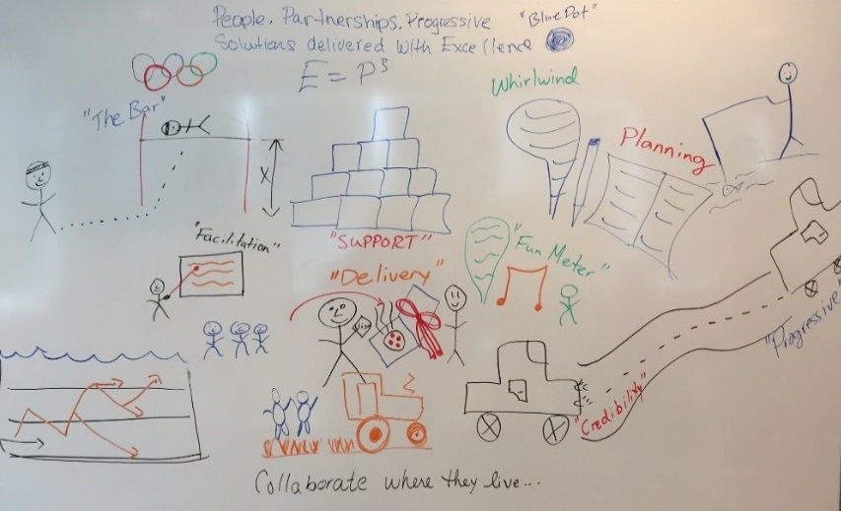
Activity: Create a vision for our ideal team
What would our ideal team look like?
Consider:
Empowerment
Recognition
Team Environment
Communication
Business Alignment
Source: McLean & Company
Notes:
Facilitator Notes:
Allow 20 minutes.
This exercise is a creative way to get your team to think about what’s important to them and how they’d like the team to be in the future. Sometimes it helps to get a starting idea on the board. You can ask someone for an idea or contribute your own. Depending on your team, you may want one person to draw while others contribute the ideas, or everyone can draw together.
Materials Required:
Flip chart or whiteboard, markers
Speaker’s Notes:
I’d like us to visualize what our ideal team would look and feel like. The idea here is to use pictures, but we can use words to provide descriptions. This will give us a great visual to describe the team we’d like to be.
Consider, but don’t limit ourselves to:
Communication
Team’s work environment
Recognition
Employee empowerment
Alignment and support of the business

Slide 39
Activity: Identify drivers to maintain and improve
Improve
Leverage
Driver
Driver
Driver
Importance
Evaluate
Maintain
Driver
Driver
Driver
Score
Notes:
Facilitator Notes:
The purpose of this exercise is to review the engagement survey results and analyze them using score and importance to the employees’ engagement; this can be completed at team and department levels depending on the participants. Drivers in the improve quadrant will be the focus of action planning.
Materials Required:
Engagement report
Markers
Whiteboard
Instructions:
Draw a two-by-two box on the whiteboard, labeling the y-axis as importance and the x-axis as score; continuum along the axis is low to high.
1. Divide the group into small groups of two or three individuals (for large teams only).
2. Ask each group to review the engagement survey report, identifying:
Top five and bottom five drivers by score
Top five and bottom five drivers by importance
3. Next, ask each group to write each of these on a sticky note and place them in the quadrant they feel is most reflective of its importance/score.
4. Next, discuss placements in each quadrant as a group and select the top three for each of the following categories:
Improve – High importance, Low score
Evaluate – Low importance, Low score
Leverage – High score, High importance
Maintain – High score, Low importance
5. Finally, isolate the top three areas to leverage and the top three areas to improve.
Remind participants that those in the improve quadrant are drivers that will provide the greatest ROI and should be the focus for initiatives to improve engagement.
Those in the leverage quadrant are successful drivers and should be kept top of mind in order to continue or build on their achievements.

Slide 40
Activity: Team Focus Group
Currently
Working
Well
Actions
to
Improve
For each driver:
What is currently working well?
What actions can the team take to improve the driver?
Driver 1
Idea
Idea
Idea
Driver 2
Idea
Idea
Idea
Idea
Idea
Idea
Driver 3
Idea
Notes:
Facilitator Notes:
Allow 30 minutes.
The purpose of this activity is to select actions the team can take to improve engagement in key engagement driver areas.
In preparation, select one to three drivers from the engagement survey as the focus of your team action plan.
Materials Required:
Flip chart paper and markers
Speaker’s Notes:
Let’s identify actions we can take as a team to improve engagement. The three drivers we have selected for action planning are: (name drivers).
For each of the drivers, what is currently working well and what actions can we take to improve?

Slide 41
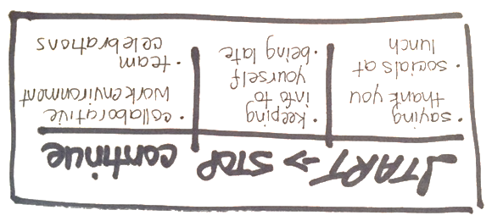
Activity: What should we stop, start, or continue?
What can we stop, start, or continue doing to increase engagement and move towards our ideal team?
What is one action that is outside of the team’s scope that you’d like senior management to stop, start, or continue?
Notes:
Facilitator Notes:
Allow 30 minutes.
The purpose of this activity is to select actions the team can take to improve engagement not connected to any specific driver.
Have flip chart sheet for each category (Start, Stop, and Continue) or draw three columns on a whiteboard and title them appropriately.
Be sure to assign and document accountabilities and timeframes for action items.
Materials Required:
Flip chart or whiteboard, markers
Speaker’s Notes:
What can we stop, start, or continue doing to help us increase engagement and achieve our ideal team? The key is to identify things that are within our control.
We’ll begin with start. (Use a flip chart to record the ideas of what the team would like to begin doing.)
Next, what would we like to stop doing that will impact the team positively? What is preventing us from achieving that ideal team now?
And finally, let’s not forget the things that are currently working well. What should we continue doing?
Given our list, which items do we want to prioritize (from the list of start items, have the team vote to choose priority action items).
With our list or prioritized items, let’s set an action plan.
(Assign and document roles, responsibilities, accountabilities, and timeframes for each item).
In addition to what’s in the control of our team, is there one action that you’d like to share with senior management? This must be outside of our scope.
While there’s no guarantee that our idea will be implemented, it will be shared with senior management. Pick the thing that would move the needle or that you think is making a difference now. For example, some folks have found that the opportunity to ask senior leadership questions in the fireside chats has really helped them to understand the rationale behind some decisions. Understanding this context has made them more comfortable with the direction that the business was taking.

Slide 42

Activity: World Café
This activity will include four rounds of group discussion, 20 minutes each. Each table group will need to select a “host.”
To start, discuss the question at your table. Write, draw, or note key ideas on the placemat.
After 20 minutes, hosts will remain at the tables, but all other participants will rotate to the next table. The host will review the key points from the previous group. Then, the new group will build and expand on their ideas.
After four rounds are completed, we will come back together for a large group debrief.
Activity adapted from The World Café Community Foundation
Notes:
Activity adapted from The World Café Community Foundation
Facilitator Notes:
This activity is based on the belief that everyone in a group brings wisdom and that the group is wiser together, not as individuals.
The goal is to promote collaboration through meaningful discussions about the things that matter to your group. This method allows for team members to share and build upon diverse thoughts and perspectives.
This activity is best suited for larger groups (of at least 12) and will require a minimum of one hour to complete.
Materials Required:
Tables, chairs, several markers of different colours, flip chart paper or large placemat paper, tape, wall/window space for posting work
Setup:
Create an inviting, safe space. Offer coffee or other refreshments; use brightly colored table coverings.
Set up the appropriate number of tables based on four chairs per table.
Place flip chart or other large sheet of paper across each table with several markers of different colors.
Instructions:
Determine the theme of the conversation. This is activity is flexible – it can be based on a single question or questions that build upon each other as participants move through each table.
Possible questions may be:
What do we do well with respect to the _______ engagement driver?
What does the ideal state look like to _________ engagement driver?
What actions will help improve _________ engagement driver?
What can I do to improve my own sense of engagement?
What do I need from my manager/organization to improve my engagement?
How can I contribute to my team’s engagement?
Place one question on each table – by writing it on a card or a handout or in large writing on the large paper.
Split the larger group into groups of four and have each group sit at the tables.
At each table, participants may write, draw, or note key ideas and discuss with others at the table. Allow 20 minutes.
After the first round of discussion, have one person at each table stay as they will be the table host for other groups. They will be there to welcome new groups and provide context of previous discussions. The remaining group members will rotate to the next table.
Groups continue their discussion at each new table, building upon or adding new ideas from what is already there. They will complete the rotation when they are back at their original table.
As groups move through the different tables, themes will start to emerge and link, and each group will have been exposed to insights and ideas from all other groups.
Tape all flip charts/placemats on a wall or window.
Discuss and share insights and discoveries as a large group. Identify patterns, increase the group’s knowledge, and talk about potential actions that may result from this activity.

Slide 43
Activity: Team Progress
Once the team has selected initiatives, use this to continue discussions and track progress on a regular basis.
Team Initiative | We don’t do this well | We sometimes do this well | We often do this well
Conduct monthly department meetings
Have quarterly offsite team socials
Get training on software
Have bi-weekly one-on-one meetings with manager
Has been in place long term
Have never done this. Budget?
Inconsistent training
Notes:
Team Engagement Action Plan: Team Progress
Facilitator Notes:
This activity is done after the team has agreed on the initiatives they will work on to improve engagement.
Allow 10-20 minutes.
Use flip chart to create a table and list the specific initiatives on the left side, followed by “We don’t do this well,” “We sometimes do this well,” and “We often do this well.”
Discuss as a group and decide which column each initiative fits in by placing a large sticky note in the appropriate box. For anything identified as “We don’t do this well” or “We sometimes do this well,” discuss why and list any additional actions needed to improve. For anything in “We often do this well,” celebrate successes as a team!
Revisit this chart on a regular basis as a team (e.g. monthly) and update the chart by moving the sticky notes and adding or crossing off actions within the initiative.
For example, the team may initially determine that software training is currently in “We don’t do this well” and list three programs to be trained on. In the following month, they may move the sticky to “We sometimes do this well” and cross off one of the training programs that was completed, leaving the two outstanding on the list. Later, it may move to “We do this well” when all three training sessions have been completed and there is a schedule set up for future sessions.
Materials Required:
Flip chart, markers, large sticky notes
Speaker’s Notes:
Now that we have reviewed our results and determined what goals/actions to focus on for our team, I’d like us to think about how we currently perform for each goal/action.
As we work through the list, we’ll discuss each item and decide as a group whether we would rate the initiative as something we don’t do well, we sometimes do well, and we often do well.
We will also identify any additional actions that need to be taken to make our initiative successful.
Discuss any significant differences in opinion. Encourage the team to share why they have chosen their position by asking “Why do you think that is?” List any additional actions or changes to make that initiative successful. Cross off items as they are complete or add as necessary.

Slide 44
Activity: Ditch a task
This activity allows individuals and teams to think about tasks they would rather not do and develop alternative solutions by reassigning and/or improving the tasks. This can be completed as a team or as a one-on-one discussion.
Must be done by team member | Can be done by another team member | Remove completely | Recommendations for improvement
Create Salesforce Cases
Schedule Time Each Week
Closing Salesforce Cases
24/7 Client Support
Rotate On-Call Between Team Members
Notes:
Ditch a Task – group activity or one-on-one discussion
Facilitator Notes:
As a group activity, this is best suited for team that can be open, honest, and candid with each other. This can also be done as a one-on-one activity between manager and team member.
Even simple daily tasks can create negative feelings at work. This activity can help identify what some of those pain points may be and determine whether they can be changed, removed, or re-assigned within a team.
While this activity may be best suited for small changes, this could also be applied as a formal exercise to determine roles and responsibilities within a team or between teams.
This activity is not intended to be a way to just offload responsibilities to other team members. It should encourage discussion about how to improve the task or swap with others, if applicable.
Create the four-column chart prior to starting the activity and label each column (must stay with current team member, can be done by another team member, remove completely, recommended changes). Create several rows and add as needed.
Materials Required:
Sticky notes, markers, flip chart paper, tape
Instructions:
Create chart prior to starting the activity.
Using one sticky note per task, have individuals brainstorm tasks they would really rather not do. Once completed, everyone posts their sticky notes on a wall, in random order.
Have team members place sticky notes one per row, in one of the “must stay," "can be done by another team member,” or “remove completely” column. leave “recommendations for improvement” empty at this stage.
Review as a group.
For all tasks under “must stay with me,” think about any recommended changes that can be made to improve the process and list under the “recommended for improvement” column.
For tasks under “can be done by another team member,” discuss the impact of making the change. See if there are tasks that other team members are willing to take on. Employees may decide to trade with another team member.
For tasks listed under “remove completely,” discuss the impact of removing the task and if it’s feasible to do so. If It can’t be removed, then discuss changes that might make the task a little easier.
Decide when and how any changes will be applied.
As a one-on-one discussion, discuss:
What specifically the team members do not like about the task.
What suggestions the team members have to change or improve the task.
What is the willingness of the team members to trade or take on new tasks.
If the task will be reassigned to someone else, ensure you have a conversation with the other team member.

Slide 45



Activity: Manager feedback on the 3i’s
INFORM
INTERACT
INVOLVE
What are the types of things you would like me to inform the team about?
___________
___________
___________
How can we interact better so that you feel that I know and understand you better on both a personal and professional level?
___________
___________
___________
What are the types of team decisions you want to be involved in or provide input into?
___________
___________
___________
Notes:
Facilitator Notes:
The goal of this portion of the meeting is to understand and identify the activities you can do as a manager to improve your team’s engagement.
Be open to all feedback.
If you’re unclear on something, ask for clarification, an example, or more information.
Take notes or ask an employee to take notes to be shared with the team if needed.
Materials Required:
Whiteboard, flip chart or paper, pen and markers for note taking
Speaker’s Notes:
I’d like to focus on what I personally can do to improve the team and move us closer to our ideal. Specifically, I’d like focus on what you’d like to be informed about, how we can improve our interaction or how I can get to know you better, and finally, what sorts of things you want to be involved in.

