Slide 1
BK Virus Nephropathy
Grand rounds
Kiran Babu, Fellow
UTHSC
1/17/2012

Slide 2
BK Virus Nephropathy
Introduction
Virology
Epidemiology
Pathogenesis
Diagnosis, Risk factors & screening
Treatment
Trends

Slide 3
BKV was first isolated in 1970 from a Sudanese kidney transplant recipient with ureteric stricture.
BKVAN was diagnosed in kidney transplant reciepient suspected for acute rejection in 1993 at Pittsburgh and published in 1996.
Epidemiological studies report that up to 90% of human populations become exposed to BKV by adulthood.*
Post Kidney transplantation 10-60% of recipients were noted to excrete virus in urine mainly as asymptomatic to only transient graft dysfunction.
*Randhawa PS, Vats , Shapiro R et al. BK Virus : Discovery,epidemiology and biology. Graft 2002;2 (suppl 5):S19-27

Slide 4
Immunosuppression is the main risk factor
for BKV reactivation
100
90
Radiation
Prednisone
6MP
80
CYA ME
70
CYA
FK506
OKT3
ATG/ALG
MMF
60
Percentage (%)
DACLIZUMAB
50
BASILOGMAB
Azathioprine
At Gam
THYMOGLOBIN
40
SIROLIMUS
30
FTY720
CAMPATH IH
20
EVEROLIMUS
Rejection < 12 month
BILATACEPT
10
1 year allograft survival
BKV
EFALIZUMAB
0
1960
1965
1970
1975
1980
1985
1990
1995
2000
2005
2010
Acott P BKV speaker meeting
Notes:
4
accepte in caseds

Slide 5
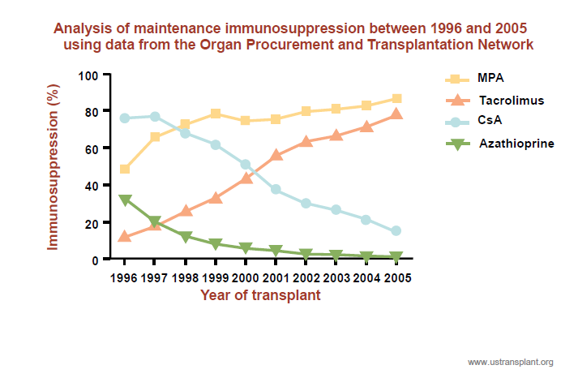
Trends in maintenance immunosuppression post-kidney transplant in US centres

Slide 8
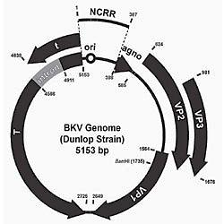
BKV genome
Double stranded Polyoma viridae family: BK virus, JC virus, SV 40
New: Polyoma virus KI, WU,MC
BKV double stranded DNA virus with 5 kb genome.
Genome comprises three regions
Non coding control region (NCCR)
Early structural coding region –Large & small T antigens
Late structural coding region – Viral capsid proteins (VP1,VP2,VP3) & Agno protein

Slide 9
Virology
NCCR contains (a) the origin of replication and b) the regulatory region containing enhancer elements that can alter viral transcription
T antigen binds tumor suppressor proteins Rb,p53 & initiates the cell cycle in host cells
VP1,VP2,VP3 are structural proteins that make up viral capsid.VP1 gene displays genetic heterogeneity and variation led to recognition of genotypes I,II,III & IV
Agno protein plays a role in several cellular processes including cell cycle progression DNA repair, Viral capsid assembly and virion release from host cell.

Slide 10
Epidemiology
Prevalence – primary infection in childhood without specific symptoms: 90% seropositive by 10yrs age.
Kidney transplant affected : 1-5%
Mode of spread : respiratory droplets
Other speculated modes are urine, semen, blood transfusion, organ transplantation.
Source : Donor, reactivation or both
Renal specificity such as tropism and ischemic injury
Viral virulence

Slide 11
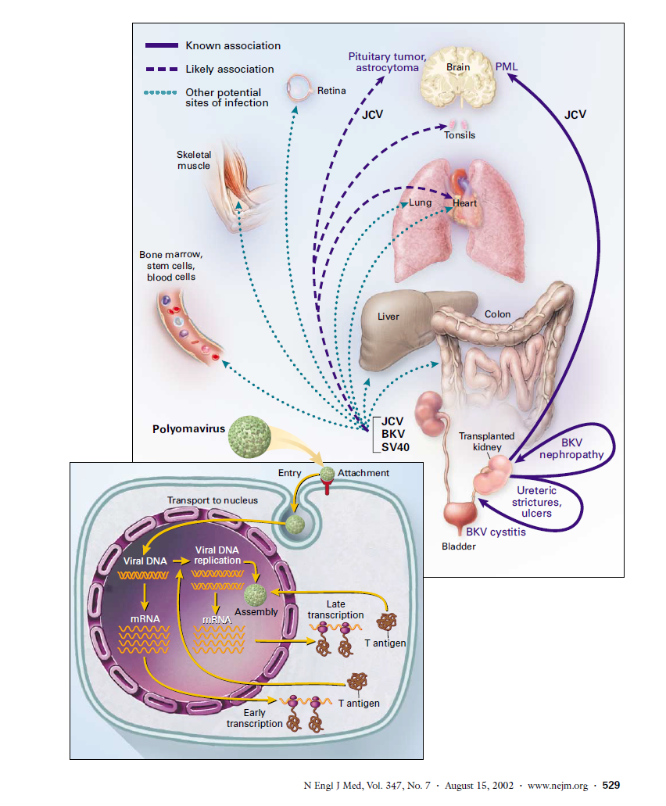

Slide 12
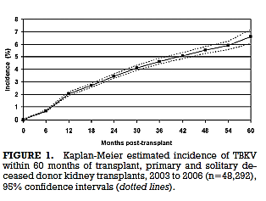
An OPTN Analysis of National Registry Data on Treatment of BK Virus Allograft Nephropathy in the United States
Case –cohort study – Primary& solitary kidney transplant recipients Jan 1 2003 thru Dec 31 2006 (OPTN database)n=48292
Recipient Variables: age at transplant, gender, ethnicity, treatment of AR within 6mo, DGF and
Induction agents : ATG, IL-2R,Alemtuzumab,No induction
Maintenance regimen : CNI based, anti-metabolites, mTORi, steroids
Donor variables : Live or deceased
Transplant variables: Donor to recipient CMV serostatus, center vol (<100 vs. 100+ TX), Transplant year
Cumulative incidence of TBKV calculated every 6 mo. for 24 mo. using KM method.
P value <0.05 significant
. Dharnidharka et al, Transplantation • Volume 87, Number 7, April 15, 2009

Slide 13
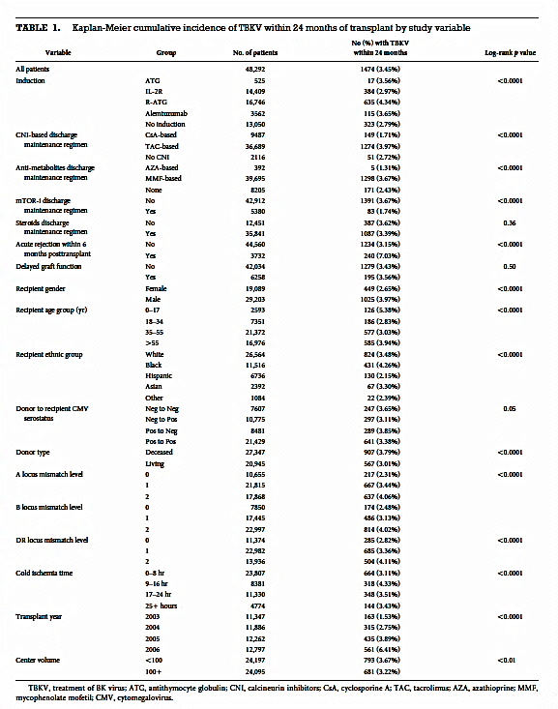
An OPTN Analysis of National Registry Data on Treatment of BK Virus Allograft Nephropathy in the United states .
Dharnidharka et al .Transplantation.Vol 87.No 7.April 15,2009

Slide 14
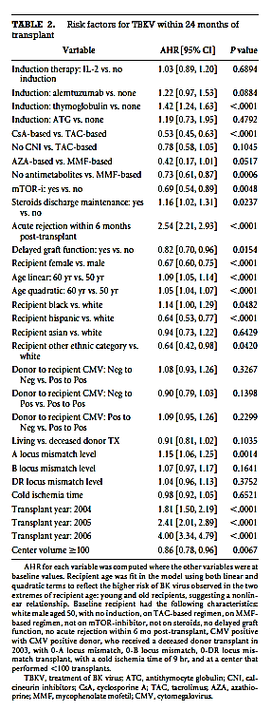
Adjusted Hazard ratio:
High risks : R ATG, Tac, MMF, AA recipients , recent Tx
R –ATG vs. IL-2R P<.001
CsA vs. no CNI P= 0.0213
Black vs. Hispanic recipients P<0.001
Asian vs. Hispanic P=0.0092
HLA A mismatch P=0.0014
AR 2.54 (P<0.001)
AR within first 6 mo. AHR 2.56 (P< 0.001)
Low risks :
DGF
Donor
mTORi
Cold ischemic time
High center vol.
An OPTN Analysis of National Registry Data on Treatment of BK Virus Allograft Nephropathy in the United states .
Dharnidharka et al .Transplantation.Vol 87.No 7.April 15,2009

Slide 15
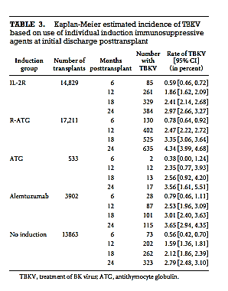
An OPTN Analysis of National Registry Data on Treatment of BK Virus Allograft Nephropathy in the United states .
Dharnidharka et al .Transplantation.Vol 87.No 7.April 15,2009

Slide 16
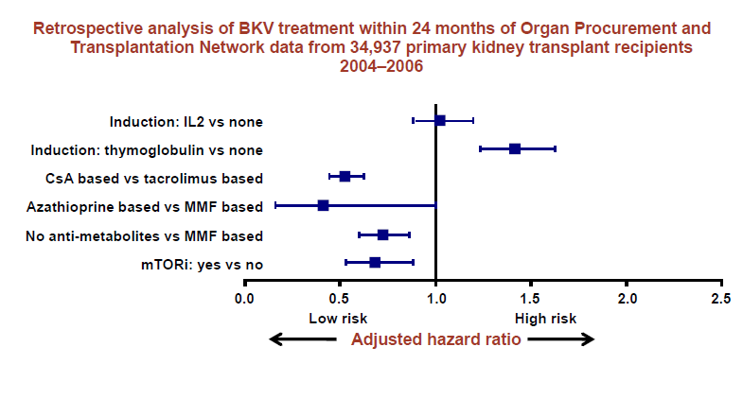
Immunosuppressive regimen may alter the risk of BKV replication

Slide 17
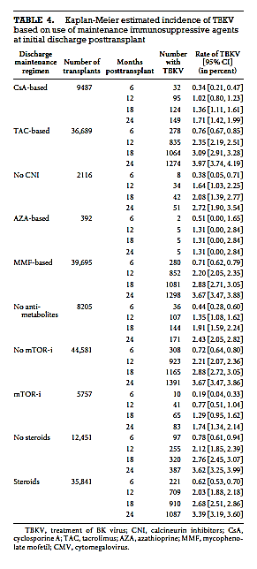
An OPTN Analysis of National Registry Data on Treatment of BK Virus Allograft Nephropathy in the United states .
Dharnidharka et al .Transplantation.Vol 87.No 7.April 15,2009

Slide 18
Immunosuppression intensity predisposes to BKV Limitations
Higher cumulative incidence due to potent IS BKV per center report
HLA A mismatch high risk for BKVN, loss Underreporting
Children at high risk : primary infection Ureteric stents not included in reporting
An OPTN Analysis of National Registry Data on Treatment of BK Virus Allograft Nephropathy in the United states .
Dharnidharka et al .Transplantation.Vol 87.No 7.April 15,2009

Slide 19
Immunology
Determined by intensity of immunosuppression rather than individual drug
Innate (Natural killer) and adaptive immunity (CD4, CD8) plays vital defense role against BKV
Humoral immunity : BKV D+/R- : BKV infection ( 43%)*
BKV D+/R+ : BKV viruria (50%)+
BKV D-/R- : BKV infection ( 10%)*+
Cellular immunity :
High BKV Abs titers , low frequency of Gamma IFN producing cells – Rec. BKV viremia#
Persistent viremia with high BKV Abs titers but weak CD8 T cells@
Alloimune activation : subclinical activation may trigger BKV replication and reactivation leading to nephritis??- mouse studies
*Shah
+Bohl
#Comoli
@Chen

Slide 20
Dendritic cell Deficiency associated with BK viremia , BKVN ?
Pilot study: Kid or Kid-Pan Tx n=79
Post Tx PBDC levels by flow cytometry (pre HD)
BK Virus measured at 1,3,6,9,12 mo.
Excluded: HBV/HCV/HIV/Infection
Variables : Renal function, gender, time of Tx
Dendritic Cell Deficiency Associated With Development of BK Viremia and Nephropathy in Renal Transplant Recipients
Womer et al. Transplantation • Volume 89, Number 1, January 15, 2010

Slide 21
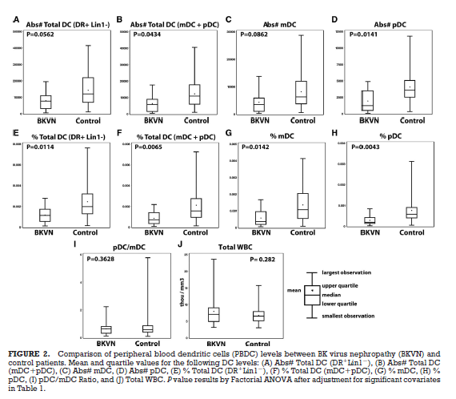
Post Transplantation Dendritic cell levels
Dendritic Cell Deficiency Associated With Development of BK Viremia and Nephropathy in Renal Transplant Recipients
Womer et al. Transplantation • Volume 89, Number 1, January 15, 2010

Slide 22
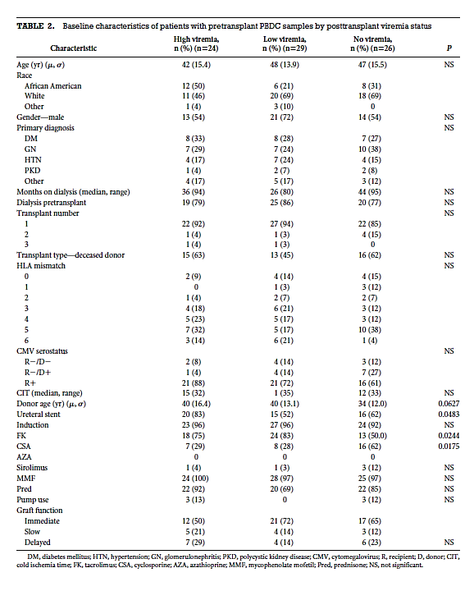
Reduction of PBDC is viral or host effect?
Pre Transplant PBDC levels by flow cytometry
Three groups
A)No viremia
B)Low viremia (<5000copies/ml)
C)High Viremia (>5000copies/ml)+ bp BVN
Result: Pre-Tx abs Total DC level 23,483 cells/ml :cut off value for predicting post-Tx viremia (LV +HV)
Sensitivity 87% and Specificity 46%
Dendritic Cell Deficiency Associated With Development of BK Viremia and Nephropathy in Renal Transplant Recipients
Womer et al. Transplantation • Volume 89, Number 1, January 15, 2010

Slide 23
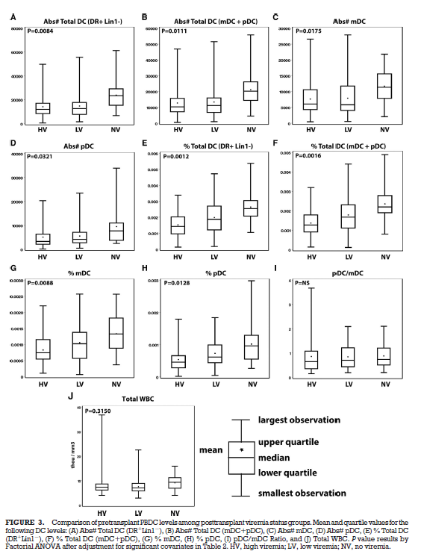
Pre transplant PBDC levels
Dendritic Cell Deficiency Associated With Development of BK Viremia and Nephropathy in Renal Transplant Recipients
Womer et al. Transplantation • Volume 89, Number 1, January 15, 2010

Slide 24
Risk factors for BKV replication and BKVN
Importance of early detection of BKV replication and BKVN
Interventions for BKV replication and BKVN

Slide 25
What are the risk factors for BKV replication?
Non-modifiable risk factors
older recipients (>65 years)¹
recipient gender: male ¹
advanced donor age (>65 years)¹
HLA mismatch ^{2,3}
acute rejection ^{2,3}
donor BKV seropositive/recipient BKV seronegative ⁴
recipient ethnic origin: african-american ²
re-transplantation ⁴
paedriatic recipient ¹
CsA, cyclosporine; A,
CsA, cyclosporine; HLA, human leukocyte antigen
MMF; mycophenolate mofetil;
BKVAN: BK polyoma virus-associated nephropathy
nephropathy
Modifiable risk factors
Immunosuppressant ²
- CNIs: tacrolimus based vs. CsA based
Induction: thymoglobulin vs. IL2 vs. none
steroids 3
Anti-metabolites: MMF based vs. azathioprine based vs none
stents ⁵
1. Schold JD et al Transpl Int 2009; 22: 626-34
2. Dharnidharka VR et al Transplantation 2009; 87: 1019-26
3. Hirsch HH et al N Engl J M 2009; 86-96
4. Bohl DL, Brennan DC. Clin J Am Soc Nephrol 2007; 2(Suppl 1): S36-46
5. Brennan DC et al Am J Translant 2005; 5:582-94

Slide 26
Intragraft inflammation supports BKVN
Risk factors of BKVAN
 | OR
HLA class I MISMATCH | 1.4
BK viruria (>10 MIO) | 61.8
Donor age > 60 y | 3.6
Acute rejection | 2.7 | Inflammation
CMV (reactivation) | 2.1
Acott P BKV speaker meeting
Notes:
26
accepte in caseds

Slide 27
Tacrolimus-based regimen is a risk factor for
BKV treatment
Retrospective analysis of scientific registry of transplant recipients data from 34,937 kidney transplant recipients 2004-2006
N-34,397 | Adjusted odds ratio for BKV treatment at month 12 post-transplant | 95% confidence interval
Tacrolimus as baseline immunosuppressionª | 1.35 | 1.04, 1.74
Thymoglobulin induction | 1.23 | 1.03, 1.45
Male recipient | 1.62 | 1.40, 1.88
Paediatric recipient (0-11 years of age) | 1.96 | 1.33, 2.89
Donor > 65 years of age | 1.88 | 1.35, 2.61
HLA mismatch | 1.36 | 1.07, 1.73
A as compared to CsA modified as baseline immunosuppression
BKV, BK virus; HLA human leukocyte antigen;
CsA, cyclosporin
11.Schold JD et al Transpl Int 2009; 22:626-34 626-34
1. Schold JD et al Transpl Int 2009; 22: 626-34
Notes:
27

Slide 28
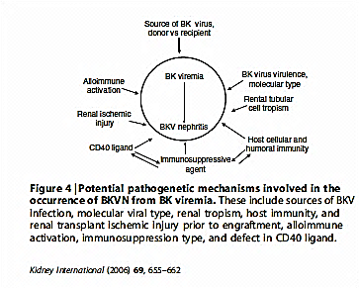
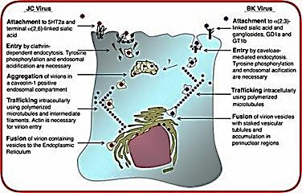
Pathogenesis

Slide 29
Clinical manifestations
Time of onset 28-40 weeks
Presents elevated S cr
Failure to respond AR TX
Foci changes progress to diffuse inflammatory changes
Extra-renal sites or native kidney not involved
Spectrum
Immunocompetent : asymptomatic shedding
Renal Tx: BKVN,Ureteral stenosis (3%),Systemic vasculopathy (rare)
BM transplants :Hemorrhagic cystitis

Slide 30
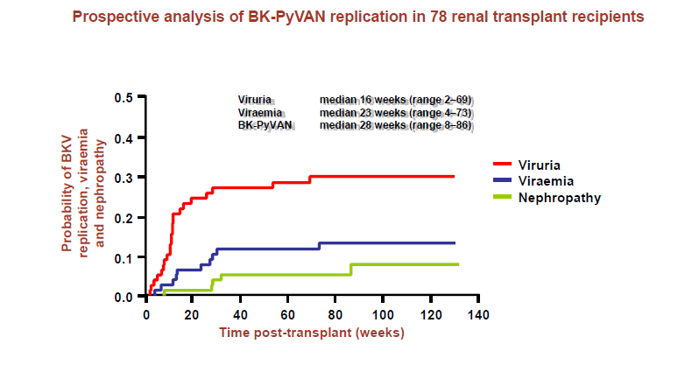
BKV Viruria and Viremia precede definitive BKVN by 6-12 weeks

Slide 31
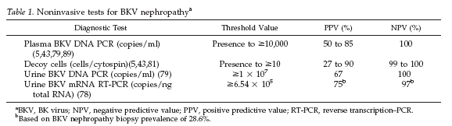
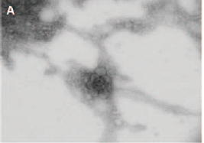
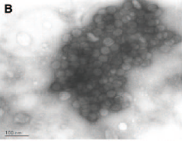
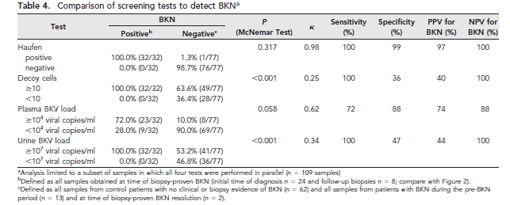
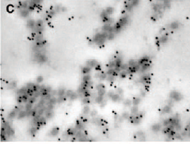

Slide 32
BKV nephropathy after KTx: diagnosis
BKVN has a focal presentation
as a consequence, negative biopsy results cannot rule out BKVN with certainty
Histological patterns
A | Viral cytopathic changes only, in near-normal renal parenchyma.
B | Combination of viral cytopathic changes and focal/multifocal areas of tubular atrophy/interstitial fibrosis/ inflammation
C | Very scarce viral cytopathic changes in diffusely scarred renal tissue. Extensive tubular atrophy/interstitial fibrosis /inflammation involving all the tissue core with no residual areas of non atrophic tubules.
Drachenberg et al. Hum Path 2005; 36:1245

Slide 33
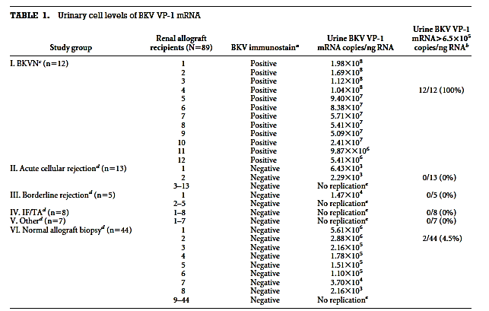
Validation of urinary BKV VP-1 mRna cut off levels for predicting BKVN and prognostic biomarkers of BKVN
Cross sectional study of Renal transplants (N=89 ) between 01-07
{Biopsies: for cause (n=45), protocol Bx n=44}
BKVN + (12) BKV - (77)
Validated 6.5X105 BKV Viral capsid mRNA /ng RNA in
urinary cells
sensitivity 100% and specificity 97%
Advantages
1.mRNA represents actively transcribed BKV
2.Urinary cell mRNA represents measuring BKV within renal
tubular cells
Disadvantages:
1.mRNA contamination from ureteric or bladder ep cells
2.mRNA are relatively unstable in comparison to DNA
3.Urinary or blood DNA levels are well established
Validation of Noninvasive Diagnosis of BK Virus Nephropathy and Identification of Prognostic Biomarkers. (Transplantation 2010;90: 189–197)

Slide 34
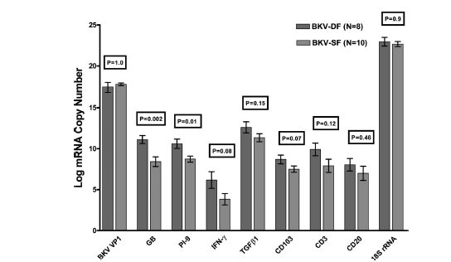
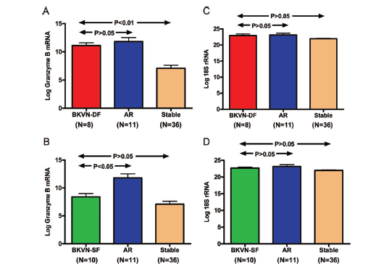
Prognosticating BKVN using urine biomarker (n= 18)
BKVDF (n=8)
BKVSF (n=10)
Granzyme B(GB) RNA (P=0.002)
Proteinase inhibitor(PI)-9 mRNA P=0.04
High GB in BKVDF & AR implies ongoing intragraft inflammation.
? BKVN co exit with AR
Individualize Immunosuppression reduction
Validation of Noninvasive Diagnosis of BK Virus Nephropathy and Identification of Prognostic Biomarkers. (Transplantation 2010;90: 189–197)

Slide 35
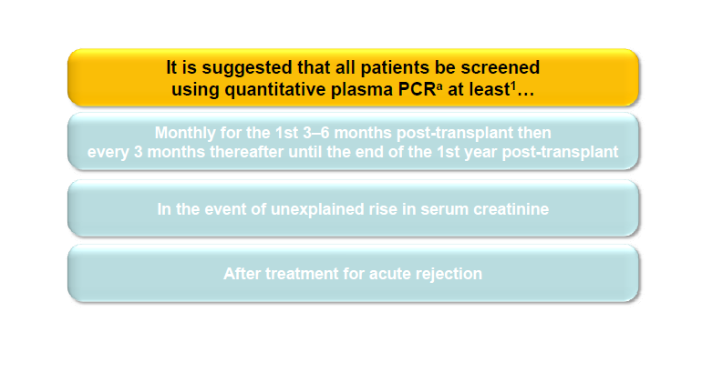
Screening for BKV replication
KDIGO guidelines

Slide 36
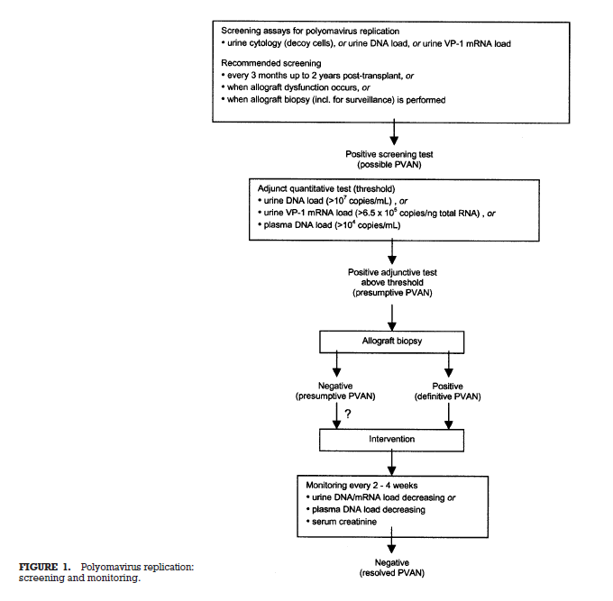


Slide 37
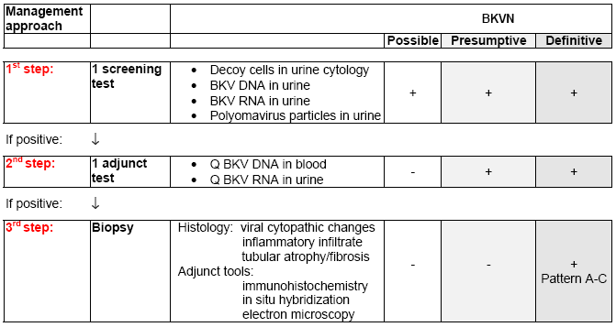
Approach to screening for BKVN diagnosis
Ginevri F, Hirsch HH. BK polyomavirus nephropathy. 2008

Slide 38
KDIGO guidelines also outline switching to a different immunosuppressive regimen
Switch to be made | Level of evidence
Tacrolimus to CsA (through levels 100-150 ng/mL) | B-III
MMF to azathioprine (dosing≤100 mg/day) | B-III
Tacrolimus to sirolimus (through levels < 6 ng/mL) | C-III
MMF to sirolimus (through levels < 6ng/mL) | C-III
MMF to leflunomide ª | C-III
B, moderate evidence to support a recommendation for use;
C, poor evidence to support a recommendation;
III, evidence from opinions of respected authorities based on clinical
experience, descriptive studies or reports of expert committee
KDIGO, kidney disease, improving global outcomes;
Transplantation 2005; 79: 1277-86
KDIGO Transplant Work Group
Am J Transplant 2009; 9(suppl 3): S44-68

Slide 39
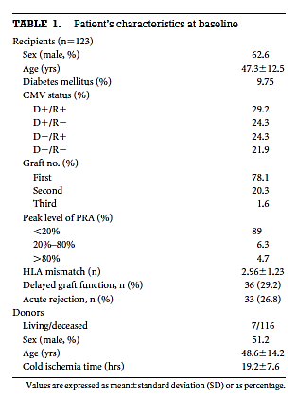
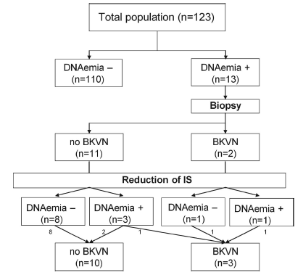

Does reduction of IS in viremic pts prevent BKVN in DE novo Renal TX recipients?
Prospective study
Almeras et al . Transplantation vol 85,Number 8,April 27,2008.

Slide 40
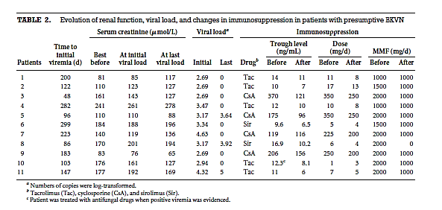
Does reduction of IS in viremic pts prevent BKVN in DE novo Renal TX recipients?
Prospective study
Almeras et al . Transplantation vol 85,Number 8,April 27,2008.

Slide 41
Early reduction in immunosuppression is associated with resolution of BKV replication and BKVN prevention
 | Brennan et al¹ (n=200,CsA66,FK134) | Ginevri et al² (n=62) | Saad et al³ (n=24) | Almeras et al4 (n=13)
Viremia n(%) Popln | 23(12) Adult | 13(20.9) Paedriatic | 24(100) Adult | 13 (10.5%) Adult
Intervention | Step 1: Stop MMF or azathioprine Step 2: reduce CNI | Step 1: reduce CNI Step 2: reduce or stop MMF | Reduce CNI (50%) and ReduceMMF(50%) | Reduce CNI (25%) & ↓MMF (50%)
Outcome at 1 yr Clearance of viremia Mean time to clearance BKVN / Graft loss Acute rejection, n(%) | 95% (22/23) pts 54 days (7-213) 0/0 1(4.3) | 100% 2 mo (1-8) 0/0 1(7.7) | 100% 5.8 mo (1-9.5) 0/1 3(13) | 72% 6months 1/0 2(2/13)
Long-term (5-yr) follow-up⁴ patient survival graft survival acute rejection | 91% 84% 12% | n/a | n/a | n/a
1. Brennan et al BK-Virus and the impact of Pre-emptive IS reduction :5 year results AM J Transplantation 2010:10:407-15
2.Ginveri et al Prospective monitoring of Polyoma BK replication and impact of pre emptive intervention in pediatric kid recipients Am J Transplant 2007 :7:2727-35
3.Saad et al
4.Almeras et al Does reduction in IS in viremic pts prevent BKV in De novo Tx? A prospective study Transplantation vol 85 No8 Apr 2008
Notes:
41

Slide 42
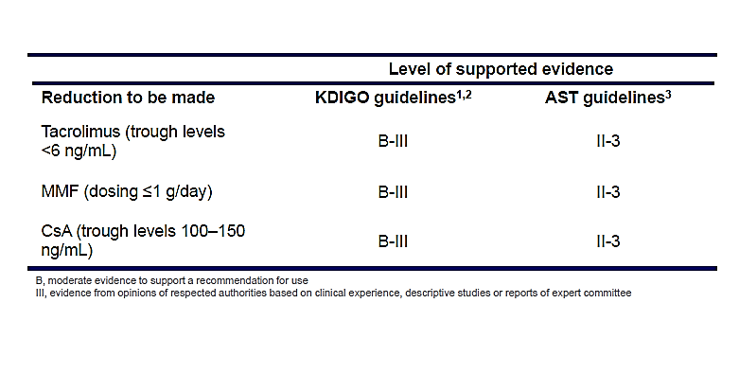

KDIGO and AST
IS Guidelines

Slide 43
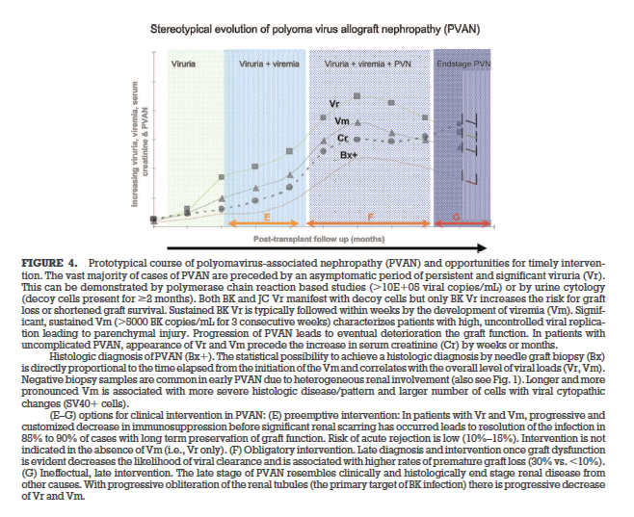
The decade of Polyoma virus BK associated Nephropathy :
State of Affairs

Slide 44
Possible interventions following BK viremia
and / or BKVN
Immunosuppression
reduction
Switching
immunosuppressive
regimen
Adjunctive
therapies
Hirsch HH et al Am J Transplant 2009; 9(Suppl 4): S136-46 KDIGO Transplant Work Group
Notes:
44

Slide 45
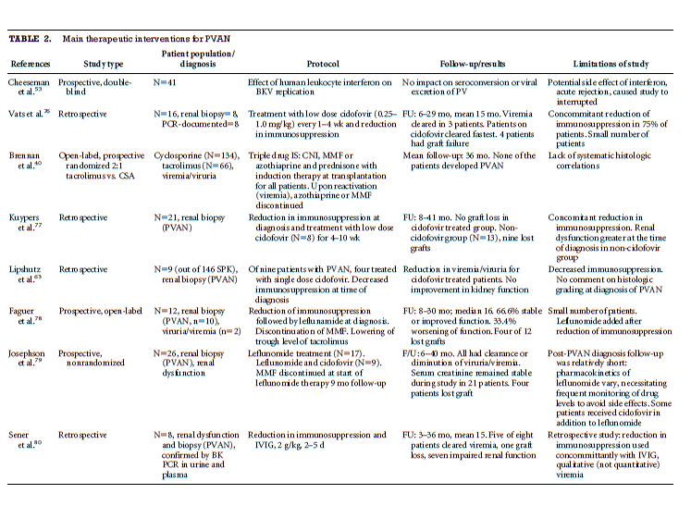
The decade of Polyoma virus BK associated Nephropathy : state of Affairs

Slide 46
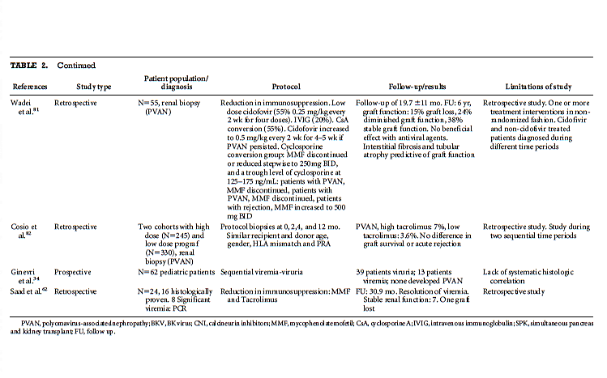
contd

Slide 47
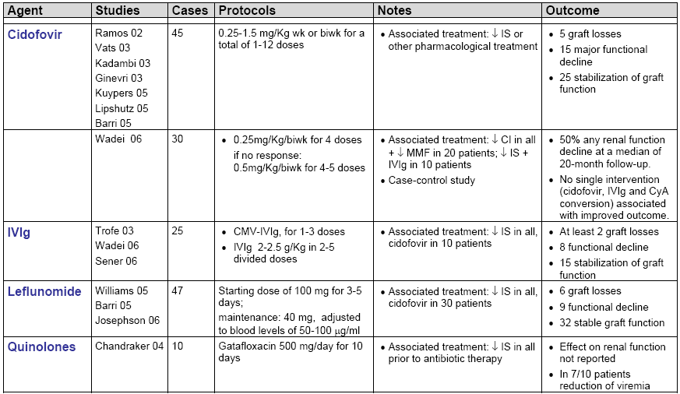
Treatment of “definitive” BKVN
The therapeutic mainstay is reduction of maintenance immunosuppression
Antivirals and other pharmacologic approaches have been variably associated
Ginevri F, Hirsch HH. BK polyomavirus nephropathy. 2008

Slide 48
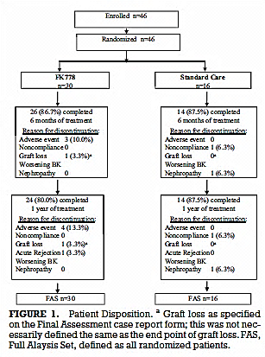
Assessment of Efficacy and safety of FK778 in comparison with Std care in renal Tx recipients with Untreated BK Nephropathy
Randomized open label parallel assignment study
for safety and efficacy (N=46)
Primary outcome measures : change from baseline in urine BK viral load
Secondary outcome measures :
a. change from baseline in plasma BK viral load
b. change from baseline in renal function (SCr) and Cr Cl at 6mos or end o f therapy whichever is earlier
c. change from baseline in renal histology measured by Drachenberg criteria at 6mos or end o f therapy whichever is earlier

Slide 49
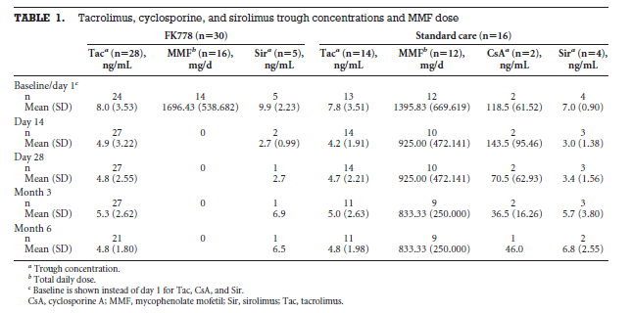

Slide 50
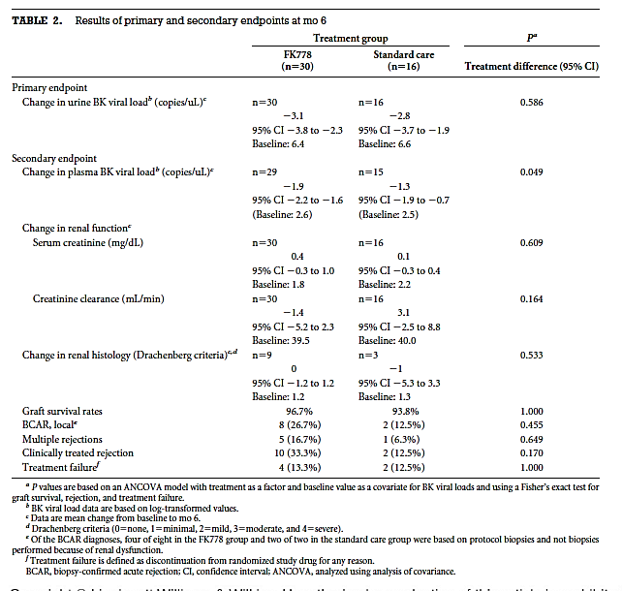

Slide 51
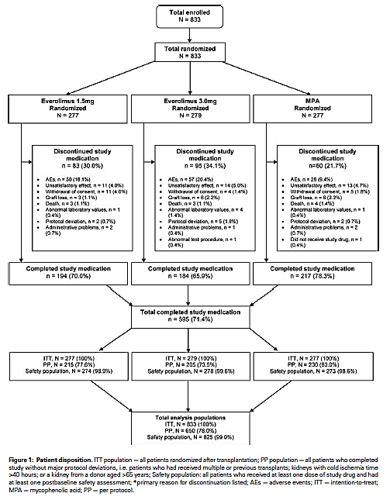
Everolimus Plus Reduced-Exposure CsA versus MMF Plus Standard-Exposure CsA in Renal-Transplant Recipients

Slide 52
Everolimus Plus Reduced-Exposure CsA versus MMF Plus Standard-Exposure CsA in Renal-Transplant Recipients
 | BK viruria | BK Viremia | BKVN
Group I Everolimus 0.75mg BID+ RD CsA | 0.7% | 1.1% | 0.4%
Group II Everolimus 1.5mg BID+ RD CsA | 0.4% | 0.7% | 0.0%
Group III MPA 720mg BID+ ST CsA | 3.3% | 1.8% | 0.7%
RD CsA trough level: 100-200ng/ml D3, 75-150 Mo2, 50-100Mo4, 25-50 Mo6-12
ST CsA trough level: 200-300ng/ml D3, 100-250ng/mL Mo2-12

Slide 53
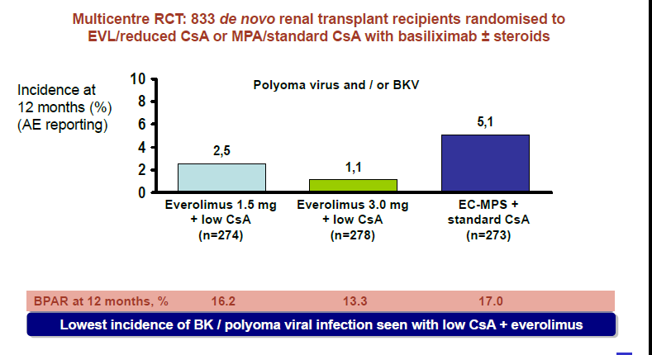
BKV/polyoma & related adv effects
Reduced CsA+mTORi vs CsA+MPA

Slide 54
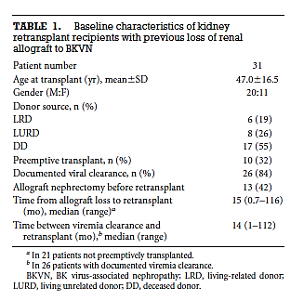
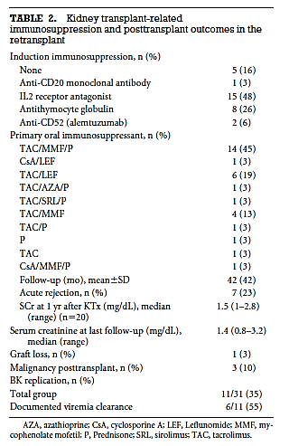
Retrospective study Re-transplantation of failed BKVN ( 6 centers) n=31
Median time after failed graft = 6 mos.

Slide 55
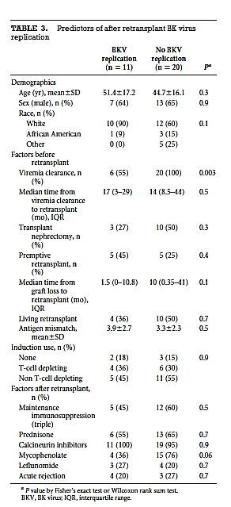
Contd
Retransplantation for BKVN failure is safe and effective if viral clearance is achieved(55% 100% P=0.003)
Viral clearance is significantly associated with lack of BKV replication post tx.
Higher S cr at 1yr in BKV replication post tx. (Scr 1.45mg/dl)
Allograft nephrectomy not determining factor.[3/22(23%) vs 8/18(44%)]

Slide 56
BK Polyoma virus infection Non renal solid organ transplants
BK Viruria prevalence – 15% -24%
Prospective longitudinal study n=60 ( Heart 7,Liver 25,Lung 28)
Urine & Plasma BKV PCR at 0,3,6,9 mos.
Results
BK Viruria : 9 (H1L3L5) Without BK Viruria :51(H6L22L23)
Induction: ATG 6/9 25/51
IL-2 2/9 17/51
None 1/9 7/51
IS: CsA 3(33%) 22(43%)
FK 5(56%) 28(55%)
CNI free 1 (11%) 1(2%)
MMF 9(100%) 46(90%)
Steroids 6(67%) 33(65%)
GFR 0 mo. 47(43-83) 66(49-89)
3mo 58.6 63.9
9mo 58 61.4
BK Viremia 0 0
Doucette et al, Prospective monitoring of BK Polyomavirus infection >early post ts in NRSOT.Tranplantation Vol 85 No12 2008

Slide 57
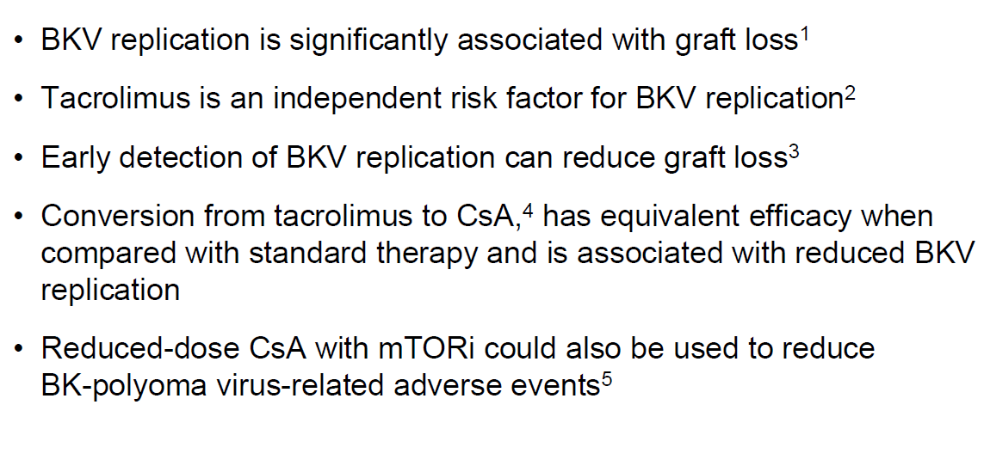
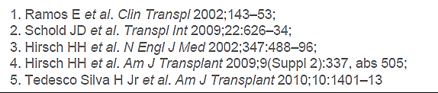
SUMMARY

Slide 58
Are BKV-specific T cells protective or destructive?
BKV specific T cell immunity
Acute BKV reactivation
chronic BKV infection
Low-level inflammation
Massive inflammation
T cell control BKV reactivation
Cytotoxic T cells damage the graft
Reduction of immunosuppression
Is required
Reduction of immunosuppression
Is harmful
Notes:
58
accepte in caseds

Slide 59
THANKYOU

