Slide 1
Library Support for Systematic Reviews
Library Training Series
SESSION 9:
Jenessa McElfresh, MLIS, AHIP

Slide 2
Outline
Define a systematic review (SR)
Explore types of evidence synthesis
Explain the SR process and requirements
Introduce UTHSC Library SR Support Service

Slide 3
Learning Outcomes
Define the purpose and outcomes of systematic review projects
1
Understand the role of systematic reviews in the context of other forms of evidence-based research synthesis
2
Examine systematic review requirements and practices as determined by national and international guidelines
3
Identify library resources and services that support systematic reviews
4

Slide 4
What is a systematic review?
Notes:
What is a systematic review? Why might you want to do one?

Slide 5
A systematic review…
…attempts to identify, appraise and synthesize all the empirical evidence that meets pre-specified eligibility criteria to answer a given research question. Researchers conducting systematic reviews use explicit methods aimed at minimizing bias, in order to produce more reliable findings that can be used to inform decision making.¹
Notes:
How do we make sense of the thousands of research articles published weekly?
When you write a systematic review, you are reporting on 2 things: The elements that combine to indicate that you followed the very strict systematic review methodology, as well as the qualitative or quantitative synthesis of the findings from your included studies.

Slide 6
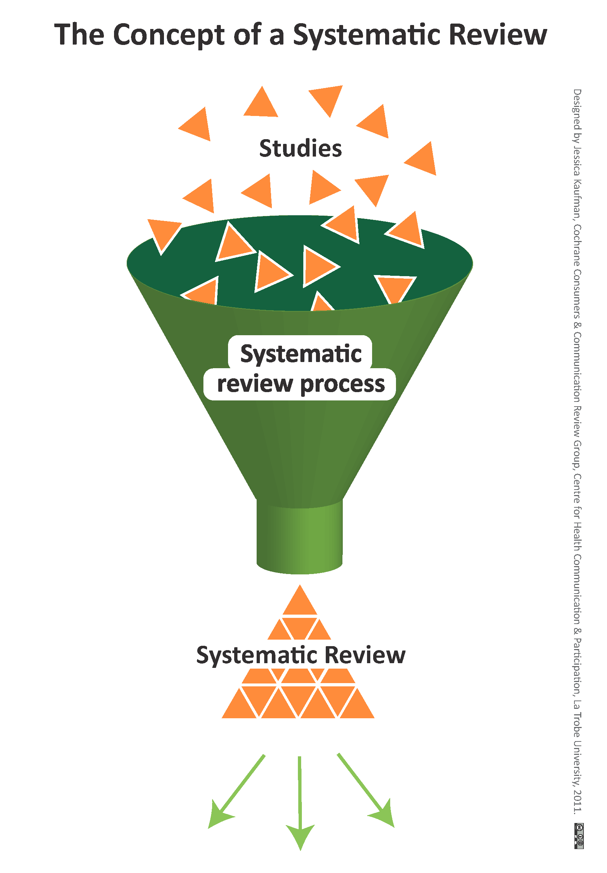
Systematic Reviews are the highest level of evidence synthesis.
The robust process and documented methodology work to eliminate bias and ensure full transparency in the data collection process, which make systematic reviews ideal for answering questions relating to healthcare and medicine.

Slide 7
Good systematic reviews are:
Rigorous
Unbiased
Transparent
Reproducible
Notes:
While these, arguably, could be the goals of all research outputs, I think that if you’ve read a scientific article in the past you know this isn’t necessary true. A good systematic review should leave the reader with no questions as to the methodology or how the authors came to their results. In essence, if completed using proper methodology and due diligence to guidelines, you should be able to pick up any systematic review and have an instruction manual to complete the review again in its entirety and come to the exact same conclusions.

Slide 8
SR methodology is defined by standards.
Cochrane: The Cochrane Handbook for Systematic Reviews of Interventions
  https://training.cochrane.org/handbook
AHRQ: Agency for Healthcare Research & Quality EBP Center Methods Guides
  https://www.ahrq.gov/research/findings/evidence-based-reports/technical/methodology/index.html
PRISMA: Preferred Reporting Items for Systematic Reviews and Meta-Analyses
  http://www.prisma-statement.org/
National Academy of Medicine (formerly IOM): Finding What Works in Health Care: Standards for Systematic Reviews
  https://pubmed.ncbi.nlm.nih.gov/24983062/

Slide 9
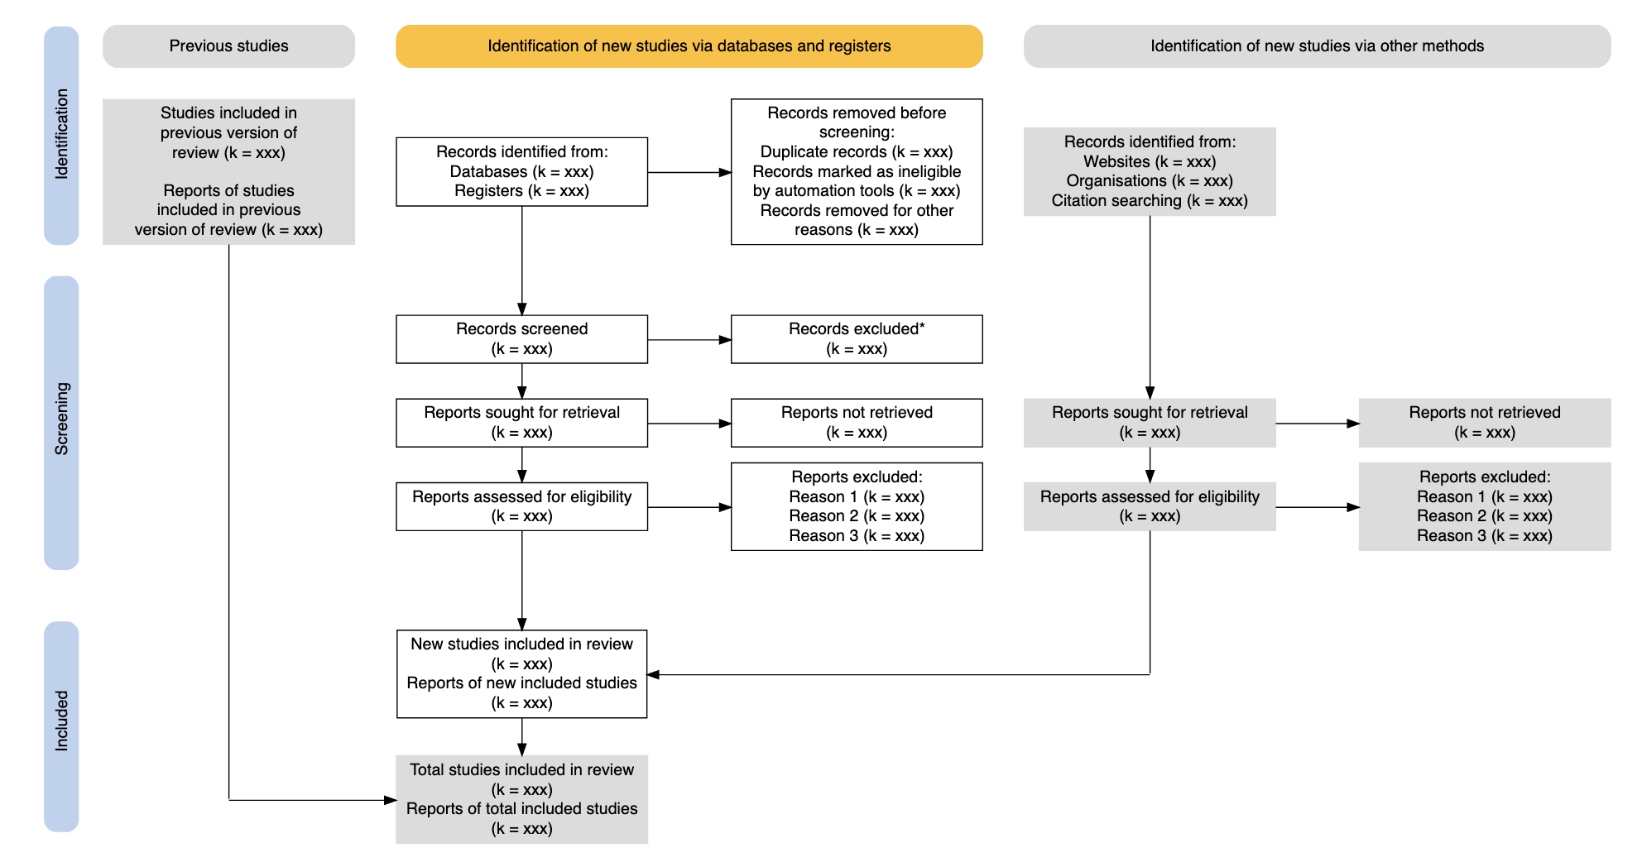
PRISMA (2020) Flow Diagram

Slide 10
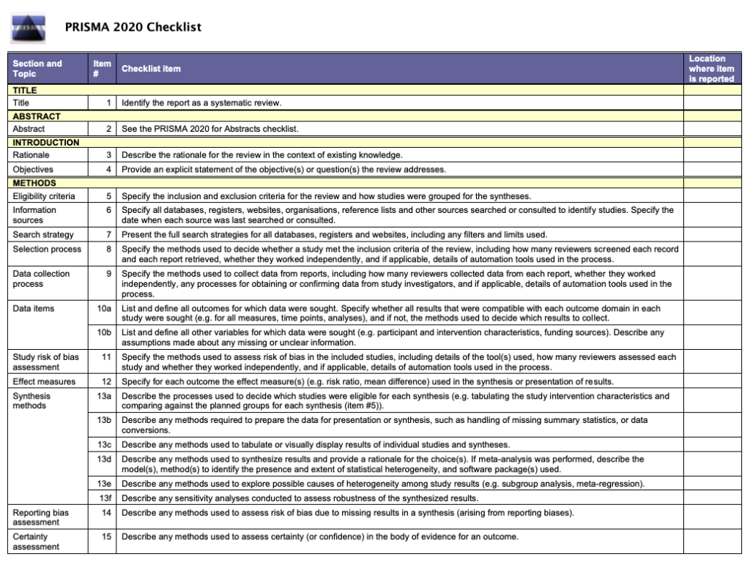
PRISMA (2020) Checklist

Slide 11
Systematic Reviews and the Clinical Researcher
Use of Primary Studies
Evidence Synthesis Research
The data and studies published by clinical researchers form the backbone of systematic review research
Knowledge of the process can enhance the discoverability and impact of your work
As an author and researcher, you may wish to synthesize existing research to validate or discover “answers” to clinical questions via a validated methodological approach.

Slide 13
How is a systematic review like or unlike other types of evidence synthesis?
Notes:
When I say evidence synthesis, I mean any sort of research activity that involves taking existing, published or otherwise available data and studies, and comparing or combining the results and methods to inform the audience.

Slide 14
Reviews in Comparison
 | Systematic Reviews | Narrative Literature Reviews
Review Question | Clearly defined and focused clinical question PICO Questions: Patient/Problem, Intervention, Comparison, Outcome | Can be general topic or specific question
Search Process | Perform searches across multiple databases Attempt to local all relevant studies Systematic, comprehensive, reproducible Document the search line by line | Perform searches of one or more databases No attempt to be exhaustive or locate all relevant studies
Inclusion and Exclusion Criteria | Explicit, predetermined descriptions of what types of studies are to be included to minimize selection bias | Usually do not describe why certain studies are included and others excluded
Number of Authors | Three or more | One or more
Time | Long (6 months – Multiple years) | Shorter (One day – a few months)
Value | Connects practicing clinicians to high quality evidence. Supports Evidence Based Practice (EBP) and healthcare decision making. | Provides summary of literature on a topic

Slide 15
Other types of reviews²
Critical Review
Literature Review
Mapping Review / Systematic Map
Meta-analysis
Mixed studies/method review
Overview
Rapid Review
Scoping Review
State-of-the-art Review
Systematic Review
Systematic Search and Review
  Qualitative Systematic Review / Qualitative Evidence Synthesis
Umbrella Review

Slide 16
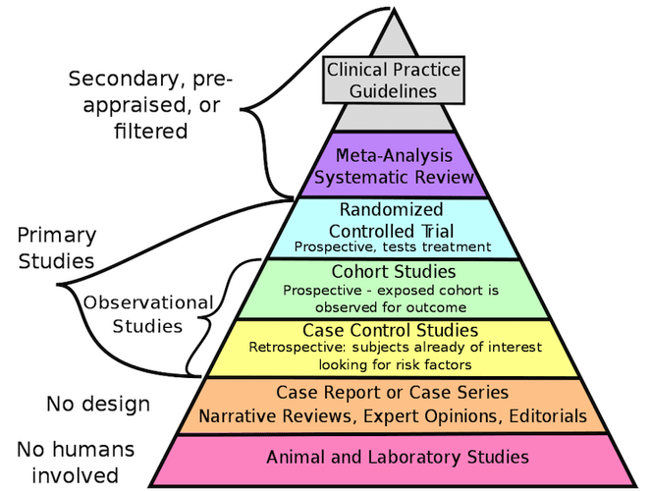
The Evidentiary Pyramid in Evidence-Based Medicine³

Slide 18
How do you conduct a systematic review, and what is required?

Slide 19
The systematic review process
Determine the research question
Assemble the research team, timeline, and guidelines
Determine if there are any registered or published SRs on the topic
Develop and register the protocol for the study
Develop a comprehensive search strategy, informed by the protocol
Extract studies from databases
Multiple rounds of screening of studies extracted
Extract and analyze data from selected studies
Interpret and synthesize results for publication
Update review as required
Publish systematic review according to journal guidelines

Slide 20
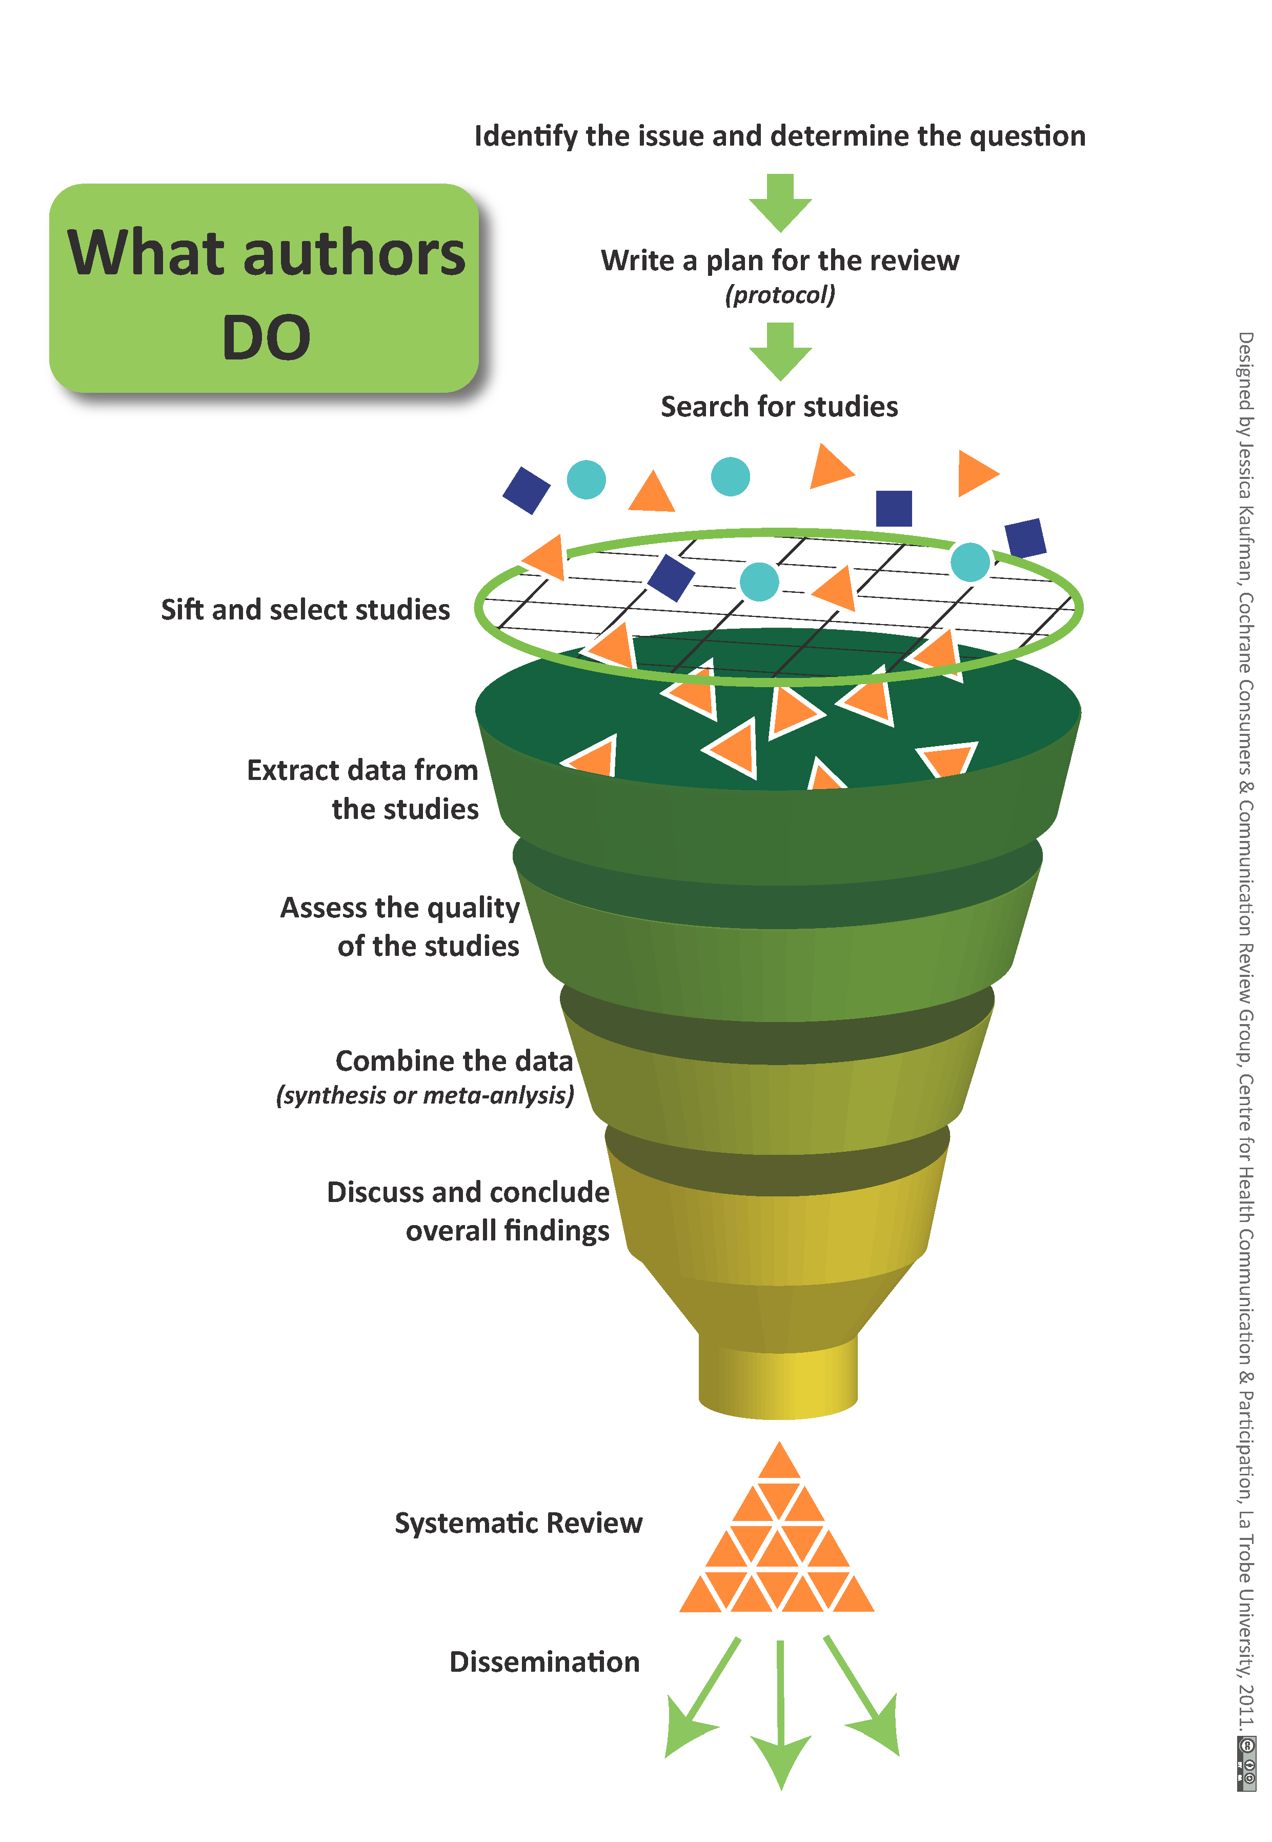
Notes:
What can go wrong in this process:
Time, money, and teams
Creating a working protocol before the review begins
Subjectivity/bias in articles evaluated and article selection process
Heterogeneity of statistical data for meta-analysis vs. narrative synthesis of overall findings
Enough data to form conclusions

Slide 21
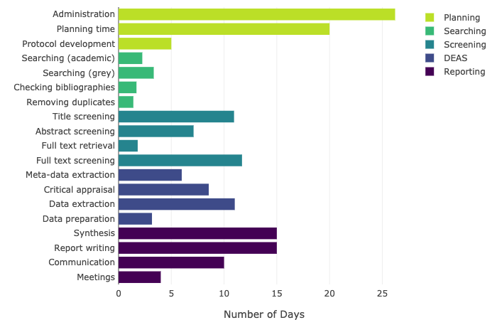
Requirements
Consider your timeline! PredicTER: http://predicter.org/
T.R.E.A.D.
Time
Resources
Expertise
Audience
Data

Slide 22
Developing a Research Topic
Questions should be
  Well-defined
  Answerable
  Searchable
Consider using PICO, PICOT, or another standardized structure
Check for already published literature
  MEDLINE
  Embase
  Cochrane Library
  PROSPERO
Notes:
Can help you answer two questions: if a review already exists, and if there is enough data/articles out there to support the systematic review process

Slide 23
Protocol Formation
The Protocol acts as the “rule book” for the review. It establishes the methodology and eliminates variation, bias, and “scope creep” later in the process.
  Protocols are essential to the SR process
Completed protocols should be registered or otherwise published in such a way that other researchers in the field can find the protocol - reducing the risk of a group attempting a review on the same topic.

Slide 24
Protocol Elements
Background
Research team and expertise
Research topic and question(s)
Inclusion and exclusion criteria
Study selection process
Data extraction process
Quality assessment and risk of bias tools
Dissemination plan
Tools like PRISMA-P can be used to develop an effective protocol

Slide 25

Registering a Protocol
Protocols in healthcare and medicine are registered, made publicly available, and kept up-to-date on PROSPERO: The International Prospective Register of Systematic Reviews

Slide 26
Developing Inclusion & Exclusion Criteria
Inclusion Example
Exclusion Example
Articles related to disease, intervention, or phenomenon of interest
Articles in English
No geographic or publishing date restrictions
Articles not related to research question
Review articles
Clinical Trials
Grey literature
Notes:
The goal is to be absolutely comprehensive on a topic! Should not be too many

Slide 27
Searching for Studies
Database search plan
  At least 3 databases with expert search competency
  Other sources
Retrieval > Relevance
Comprehensive, reproducible, exhaustive
Ample documentation and tracking of results

Slide 28
Example Search Strategy
Concept: Phytoestrogens and Diabetes⁴
MEDLINE/OVID | (exp "Phytoestrogens"/ OR "Soybeans"/ OR exp "Soybean Proteins"/ OR exp "Soy Foods"/ OR "Trifolium"/ OR exp "Isoflavones"/ OR (phytoestrogen* OR phytooestrogen* OR phyto-estrogen* OR phyto-oestrogen* OR soybean* OR soy OR "red clover" OR Trifolium OR Isoflavon* OR daidzein OR genistein* OR flaxseed OR ((herb* OR plant*) ADJ6 (estrogen* OR estrogen*)) OR tofu).ab,ti.) AND (exp "Diabetes Mellitus"/ OR "Insulin Resistance"/ OR glucose/bl OR insulin/bl OR exp Hyperinsulinism/ OR (diabet* OR ((glucose OR sugar OR insulin* ) ADJ6 (level* OR blood OR serum OR plasma* OR concentration*)) OR glucosaem* OR glucosem* OR glycaem* OR glycem* OR hyperinsulin* OR hypoinsulin* OR insulinaem* OR insulinem* OR (insulin ADJ3 (response OR dependen* OR resistan* OR sensitiv*)) ).ab,ti.) NOT (exp animals/ NOT humans/) NOT (letter OR news OR comment OR editorial OR congresses OR abstracts).pt.
Cochrane Library | ((phytoestrogen* OR phytooestrogen* OR phyto-estrogen* OR phyto-oestrogen* OR soybean* OR soy OR 'red clover' OR Trifolium OR Isoflavon* OR daidzein OR genistein* OR flaxseed OR ((herb* OR plant*) NEAR/6 (estrogen* OR estrogen*)) OR tofu):ab,ti) AND ((diabet* OR ((glucose OR sugar OR insulin* ) NEAR/6 (level* OR blood OR serum OR plasma* OR concentration*)) OR glucosaem* OR glucosem* OR glycaem* OR glycem* OR hyperinsulin* OR hypoinsulin* OR insulinaem* OR insulinem* OR (insulin NEAR/3 (response OR dependen* OR resistan* OR sensitiv*)) ):ab,ti)
Embase | ('phytoestrogen'/exp OR 'soybean'/de OR 'soybean extract'/de OR 'soybean protein'/de OR 'soybean oil'/de OR 'soybean meal'/de OR 'soybean milk'/de OR 'red clover'/de OR 'red clover extract'/de OR 'isoflavone'/de OR 'isoflavone derivative'/de OR 'daidzein'/de OR 'genistein'/de OR 'soy food'/de OR (phytoestrogen* OR phytooestrogen* OR phyto-estrogen* OR phyto-oestrogen* OR soybean* OR soy OR 'red clover' OR Trifolium OR Isoflavon* OR daidzein OR genistein* OR flaxseed OR ((herb* OR plant*) NEAR/6 (estrogen* OR estrogen*)) OR tofu):ab,ti) AND ('diabetes mellitus'/exp OR 'insulin response'/exp OR 'glucose blood level'/exp OR 'insulin blood level'/exp OR hyperinsulinism/exp OR (diabet* OR ((glucose OR sugar OR insulin* ) NEAR/6 (level* OR blood OR serum OR plasma* OR concentration*)) OR glucosaem* OR glucosem* OR glycaem* OR glycem* OR hyperinsulin* OR hypoinsulin* OR insulinaem* OR insulinem* OR (insulin NEAR/3 (response OR dependen* OR resistan* OR sensitiv*)) ):ab,ti) NOT ([animals]/lim NOT [humans]/lim) NOT ([Conference Abstract]/lim OR [Letter]/lim OR [Note]/lim OR [Editorial]/lim)

Slide 30
Managing References: EndNote 20
Embase, Medline, CINAHL, Scopus
Articles from databases
EndNote 20
Remove duplicates, retrieve full text, export to screening tool, + more

Slide 31
Article screening and selection
Usually completed in 2 stages
Title/abstract screening
Full text screening
Two independent (blinded) reviewers, with third as tie breaker
Log is kept with data from each stage of screening with number of articles excluded (with reasons)
Tools to assist:
Rayyan
Microsoft Excel
EndNote

Slide 32
Data Extraction
Data is extracted from the included studies for analysis, either qualitative or quantitative
Standardized forms for extraction are created for use by the research team
Tools: dependent on the comfort level of the research team
Microsoft Excel
Microsoft Word
More: http://systematicreviewtools.com/index.php

Slide 33
Quality Assessment
Each study that meets the inclusion criteria is assessed for quality
Additional studies may be excluded as a result of this process
Must be documented
Method 1: Utilize existing quality assessment tool, depending on RQ and SR design
Method 2: Create or modify customized QA tool from existing guidelines or criteria

Slide 34
Quality Assessment Tool Examples
GRADE
  Grading of Recommendations Assessment, Development and Evaluation
  Used for intervention studies, various research methods included
  https://www.gradeworkinggroup.org/
CASP
  Critical Appraisal Skills Programme
  Checklists for quantitative and qualitative study types
  https://casp-uk.net/

Slide 35
Discussion and Results
Applicability of results
Strength of existing evidence
Benefits, costs, and tradeoffs
Limitations
Implications for future research

Slide 36

Publishing a systematic review
Check your targeted journal(s) for specific author requirements pertaining to systematic reviews
    Protocol documentation
    Summary of findings
    Search methodology
    PRISMA charts, appendices, data tables and presentation

Slide 38
How can librarians help you with a systematic review?

Slide 39
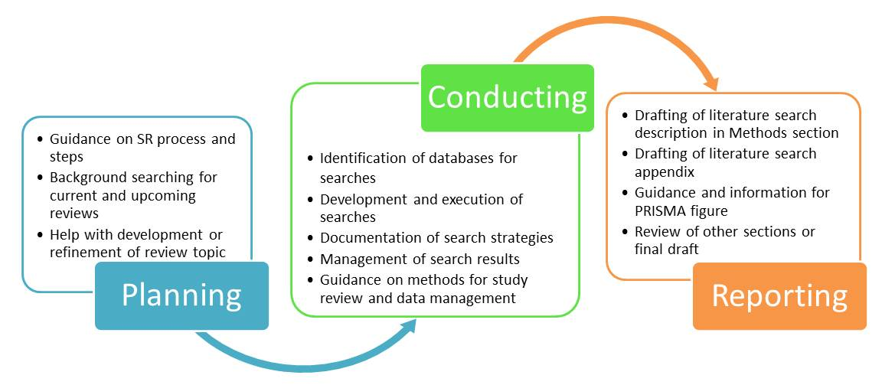
Librarians and the SR process
Image credit: UNC Chapel Hill Libraries

Slide 40
UTHSC Health Sciences Library Systematic Review Service
Tier One: Consultation
Tier Two: SR Team Member
Provide consultation on SR process and guidelines
Give advice on identifying controlled vocabulary and keywords
Provide recommendations for databases and other resources to search for evidence
Give advice on citation management methods and tools
Use PICO (Patient problem, Intervention, Comparison, and Outcome) to identify key concepts
Identify appropriate search terms: controlled vocabulary and keywords in conjunction with SR team members
Conduct literature searches across multiple databases
Document line by line database search strategies
Organize references retrieved from difference sources
Assist in retrieving full text articles
Update search results prior to the final write-up
Write up the search part of the methodology section for publication
Review manuscript

Slide 41
Criteria for Advanced Service
Limited to faculty, staff, and residents/fellows
Protocol registration in PROSPERO
3-5 benchmark references relevant to the topic
The library’s SR Protocol Form
Systematic Review Policy
  Terms of Agreement
  Responsibilities for researchers and librarians
  Co-authorship for librarians
  Timely communications

Slide 42
Library Support for Non-UTHSC Researchers
Contact your Medical Library
Support via Collaboration
Medical librarians are trained in advanced searching in a myriad of biomedical databases, and many have systematic review training to assist researchers
Ensuring diverse representation on a systematic review team gives the team access to more libraries, resources, and potentially systematic review support services!

Slide 43

Library 101 Guide https://libguides.uthsc.edu/clinicalresearchers

Slide 44
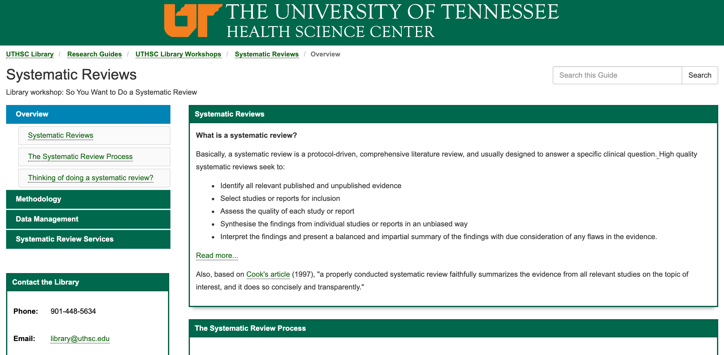
Systematic Review Research Guide https://libguides.uthsc.edu/systematicreview

Slide 45
References
About Cochrane Reviews. Cochrane Library. https://www.cochranelibrary.com/about/about-cochrane-reviews. Accessed July 19, 2021.
Grant MJ, Booth A. A typology of reviews: an analysis of 14 review types and associated methodologies. Health Info Libr J. 2009 Jun;26(2):91-108. doi: 10.1111/j.1471-1842.2009.00848.x. PMID: 19490148.
Lander B, Balka E. Exploring How Evidence is Used in Care Through an Organizational Ethnography of Two Teaching Hospitals. J Med Internet Res. 2019;21(3):e10769. Published 2019 Mar 28. doi:10.2196/10769.
Muka T, Glisic M, Milic J, et al. A 24-step guide on how to design, conduct, and successfully publish a systematic review and meta-analysis in medical research. Eur J Epidemiol. 2020;35(1):49-60. doi:10.1007/s10654-019-00576-5

Slide 46
Questions?
We’re here to help!
Email any time: library@uthsc.edu

