Slide 1
Elyra 7 LS Super-resolution Microscope: Equipment Basics
Rachel Escue Helms, PhD, Microscopy Manager
Advanced Imaging Core (AIC)

Slide 2
OVERVIEW
ADVANCED IMAGING CORE
ELYRA 7 LS SUPER-RESOLUTION MICROSCOPE: EQUIPMENT BASICS

Slide 3
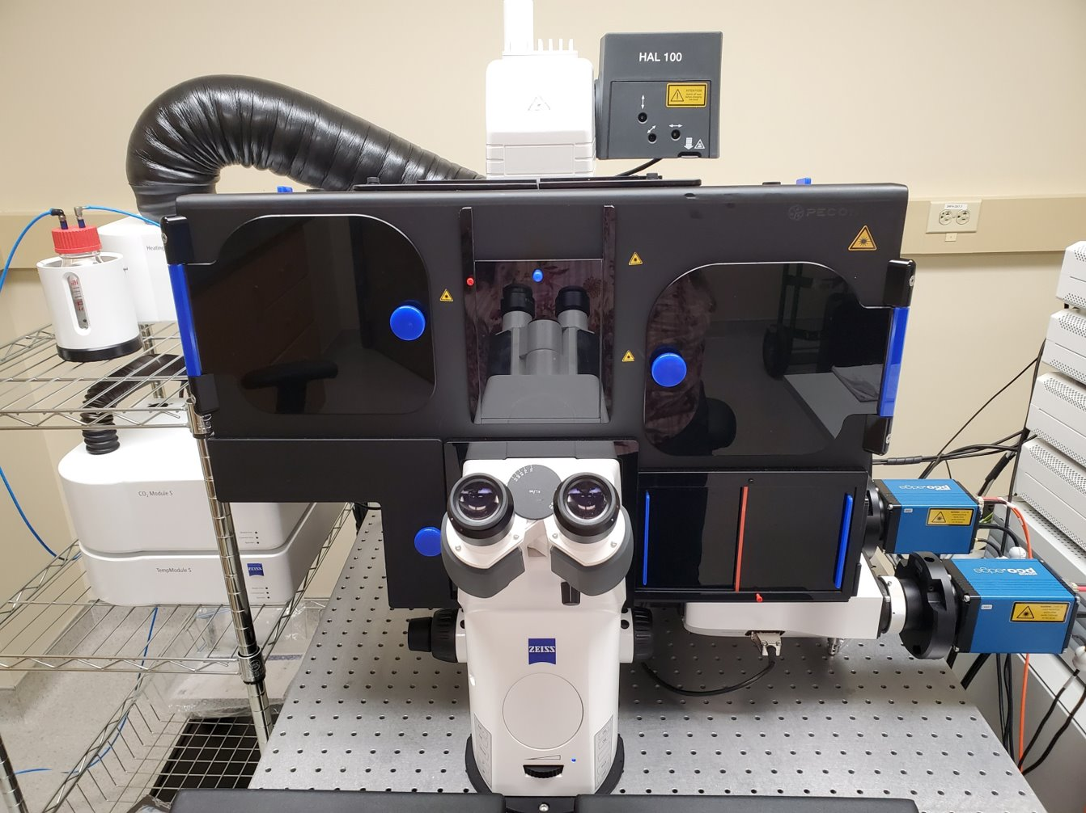
OVERVIEW
ADVANCED IMAGING CORE
ELYRA 7 LS SUPER-RESOLUTION MICROSCOPE: EQUIPMENT BASICS
1
Laser Safe Box
Binocular Eye Piece
Fine Adjustment Knob
Coarse Adjustment Knob
2
3
4

Slide 4
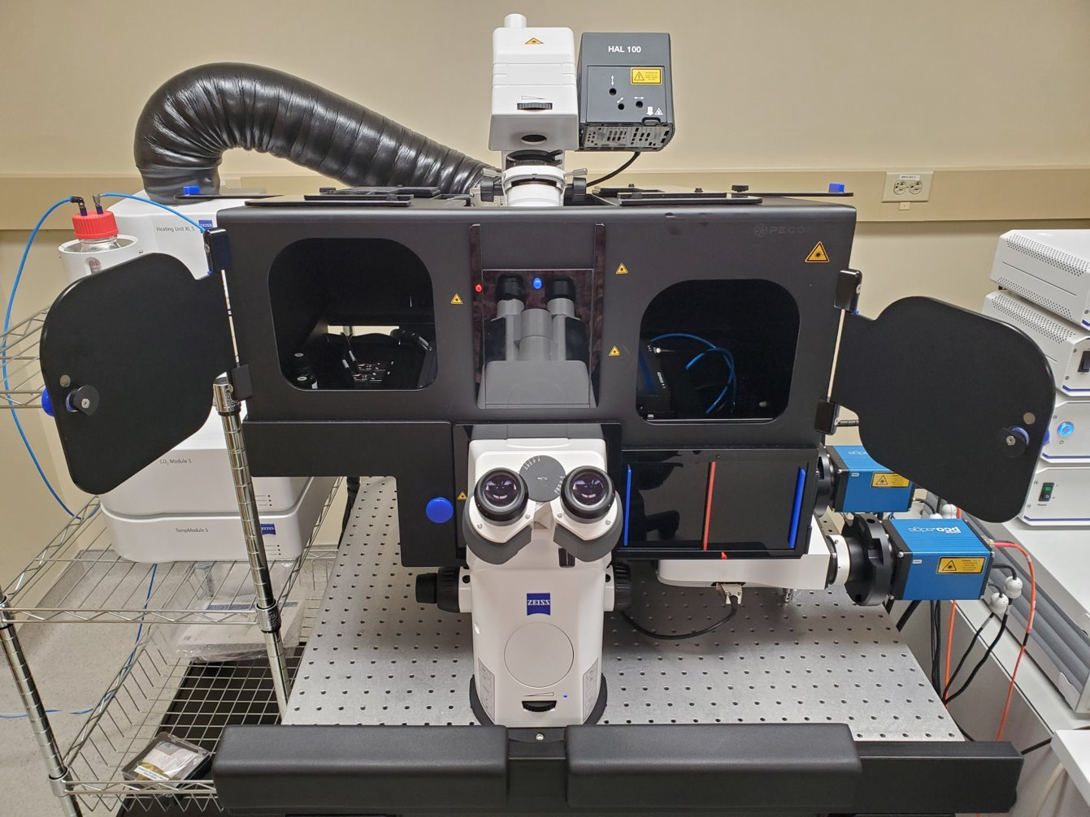
OVERVIEW
ADVANCED IMAGING CORE
ELYRA 7 LS SUPER-RESOLUTION MICROSCOPE: EQUIPMENT BASICS
Moves up to allow for sample placement
Hazard stickers: These indicate where a laser safeguard is.
--If anything is not closed completely, the lasers will not work!

Slide 5
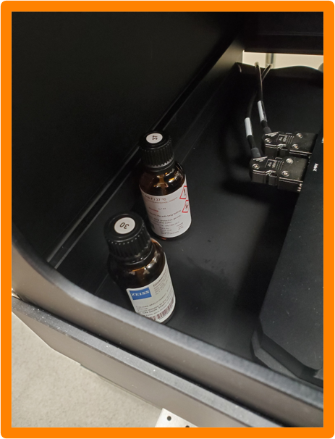
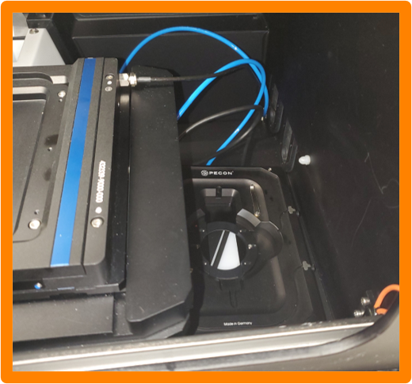
OVERVIEW
ADVANCED IMAGING CORE
ELYRA 7 LS SUPER-RESOLUTION MICROSCOPE: EQUIPMENT BASICS
Immersion Oil for Objectives (one for RT [30], one for use with incubation [37])
Incubation-capable sample holder + cover (for live cells)
1
2
2

Slide 6
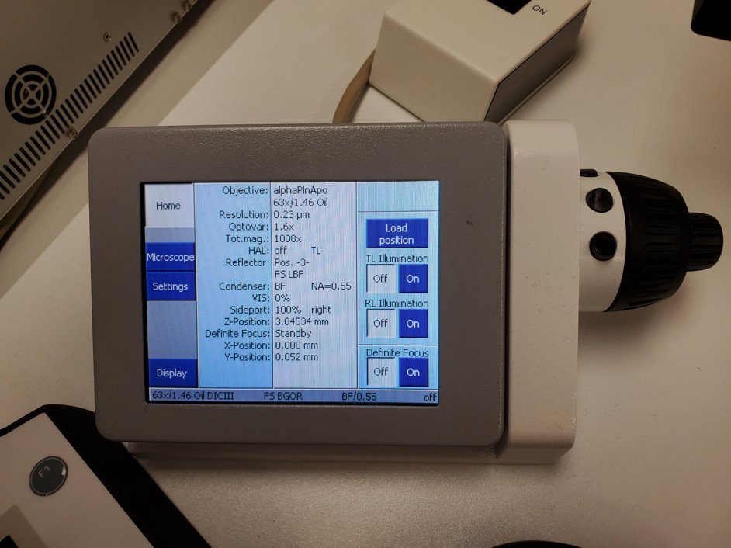
OVERVIEW
ADVANCED IMAGING CORE
ELYRA 7 LS SUPER-RESOLUTION MICROSCOPE: EQUIPMENT BASICS
Auxiliary screen for controlling the microscope.
This can be used for selecting objectives and changing the focus.

Slide 7
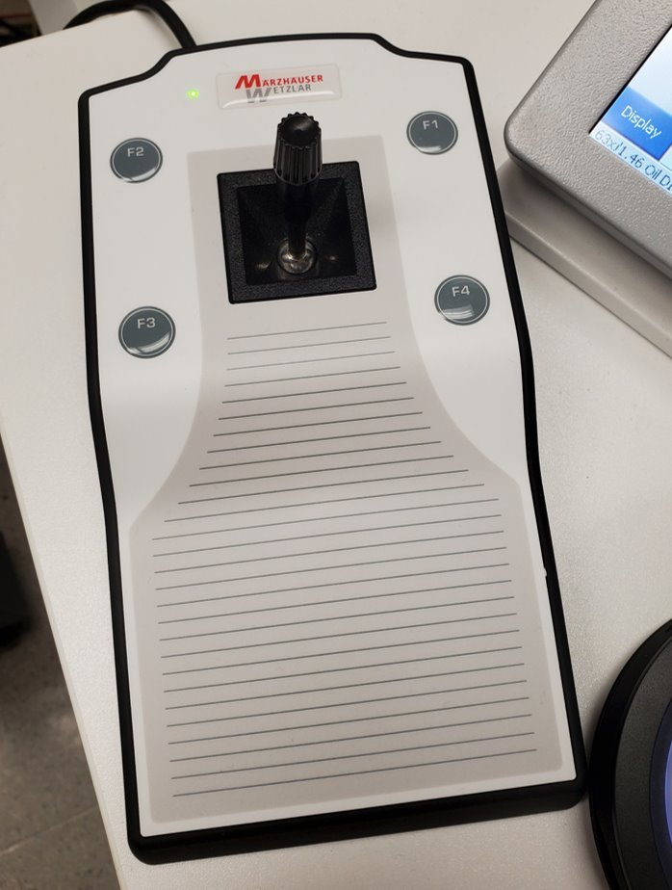
OVERVIEW
ADVANCED IMAGING CORE
ELYRA 7 LS SUPER-RESOLUTION MICROSCOPE: EQUIPMENT BASICS
Controls the motorized stage.

Slide 8
SAMPLE HOLDERS AND STAGE ADAPTERS
ADVANCED IMAGING CORE
ELYRA 7 LS SUPER-RESOLUTION MICROSCOPE: EQUIPMENT BASICS

Slide 9
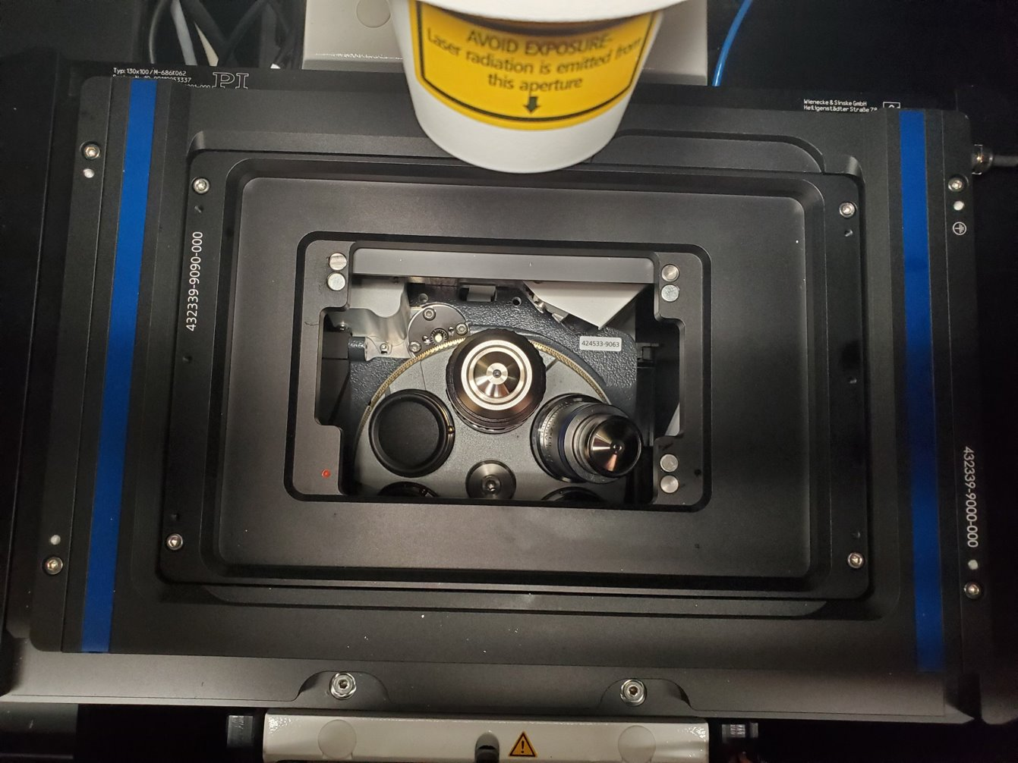
SAMPLE HOLDERS AND STAGE ADAPTERS
ADVANCED IMAGING CORE
ELYRA 7 LS SUPER-RESOLUTION MICROSCOPE: EQUIPMENT BASICS
View of stage from above, with adapter for level-adjustable sample holders installed.
Note that the left side of the stage adapter is narrower than the right. All the stage adapters are shaped this way.

Slide 10
ADVANCED IMAGING CORE
ELYRA 7 LS SUPER-RESOLUTION MICROSCOPE: EQUIPMENT BASICS
SAMPLE HOLDERS AND STAGE ADAPTERS
Arrows indicate screws for attaching the stage adapter. All of the stage adapters use these screws. The hex key for the screws can be found in the drawer containing the stage adapters and holder inserts.

Slide 11
ADVANCED IMAGING CORE
ELYRA 7 LS SUPER-RESOLUTION MICROSCOPE: EQUIPMENT BASICS
SAMPLE HOLDERS AND STAGE ADAPTERS
Please note the red dot in the bottom left of the area where the sample holder insert sits.
This is used to orient the holder, as it has a corresponding red dot in the bottom left corner.

Slide 12
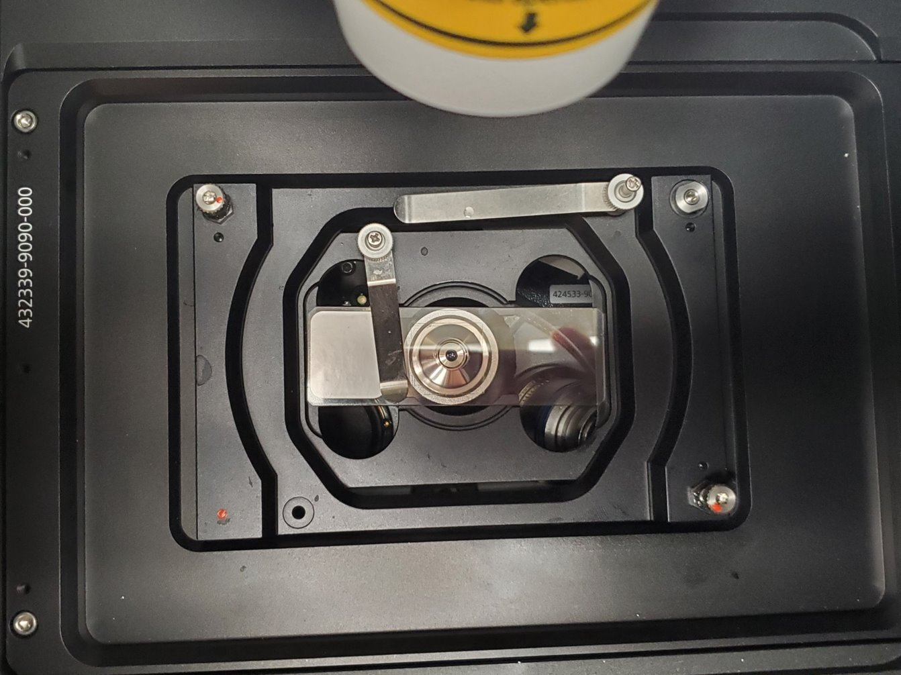
ADVANCED IMAGING CORE
ELYRA 7 LS SUPER-RESOLUTION MICROSCOPE: EQUIPMENT BASICS
SAMPLE HOLDERS AND STAGE ADAPTERS
View from above showing sample holder insert in place

Slide 13
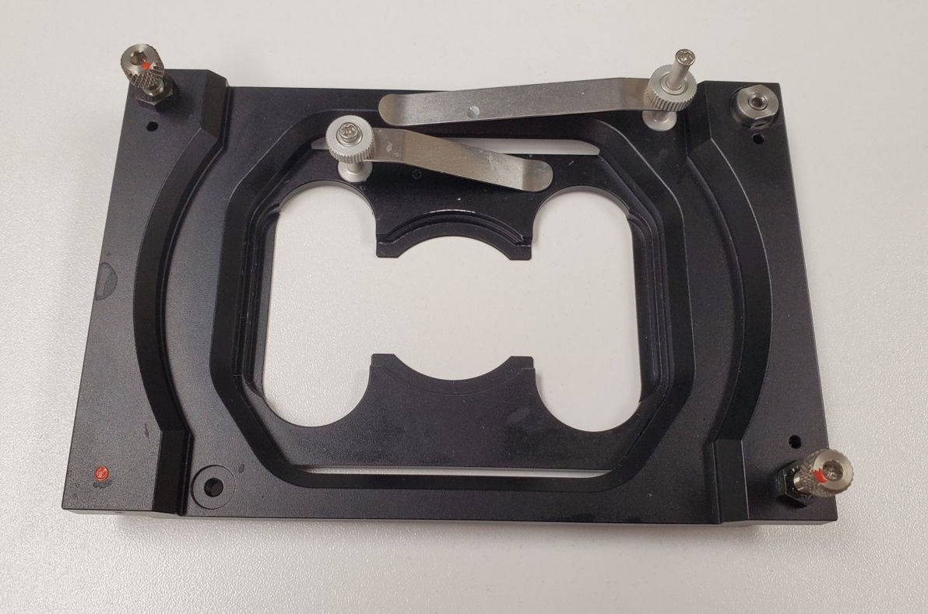
ADVANCED IMAGING CORE
ELYRA 7 LS SUPER-RESOLUTION MICROSCOPE: EQUIPMENT BASICS
SAMPLE HOLDERS AND STAGE ADAPTERS
Primary level-adjustable sample holder insert
-Suitable for SMLM applications
-Other holders and inserts are located in the drawer

Slide 14
ADVANCED IMAGING CORE
ELYRA 7 LS SUPER-RESOLUTION MICROSCOPE: EQUIPMENT BASICS
SAMPLE HOLDERS AND STAGE ADAPTERS
As this is a level-adjustable insert, be very cognizant of the leveling screws (arrows). They are very sensitive.
Note: the sample clamps are used by moving the clamp up or down. It deceivingly looks like it should be screwed tight, but it does not.

Slide 15
INCUBATION AND HEATING ELEMENTS
ADVANCED IMAGING CORE
ELYRA 7 LS SUPER-RESOLUTION MICROSCOPE: EQUIPMENT BASICS

Slide 16
INCUBATION AND HEATING ELEMENTS
ADVANCED IMAGING CORE
ELYRA 7 LS SUPER-RESOLUTION MICROSCOPE: EQUIPMENT BASICS
Not needed unless performing live-cell imaging

Slide 17
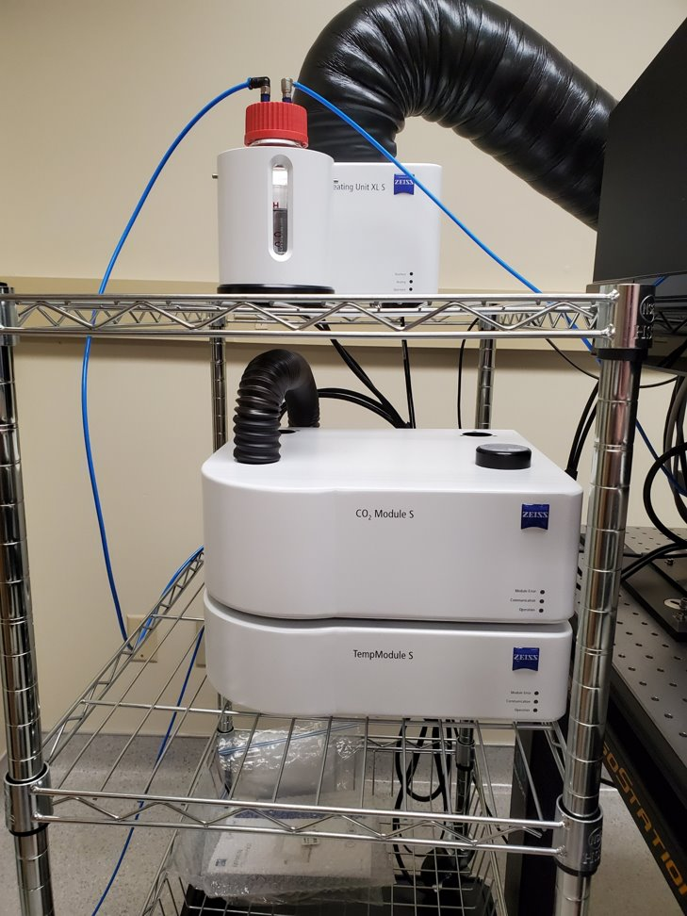
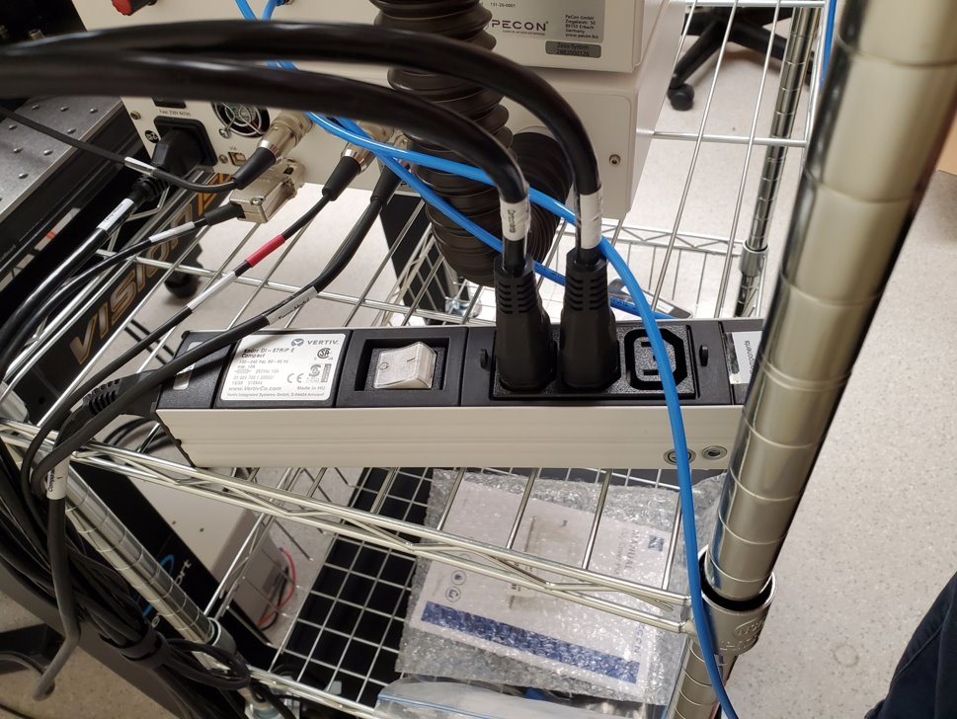
INCUBATION AND HEATING ELEMENTS
ADVANCED IMAGING CORE
ELYRA 7 LS SUPER-RESOLUTION MICROSCOPE: EQUIPMENT BASICS
Not needed unless performing live-cell imaging
*After turning on Main and Components switches, turn on power strip on rack behind the CO₂ and Temp. modules. Finally, turn on the PC.

Slide 18
ELYRA 7 STARTUP PROCEDURE
ADVANCED IMAGING CORE
ELYRA 7 LS SUPER-RESOLUTION MICROSCOPE: EQUIPMENT BASICS

Slide 19
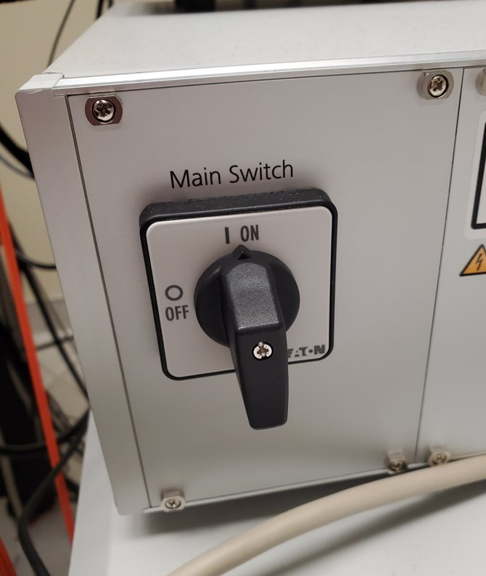
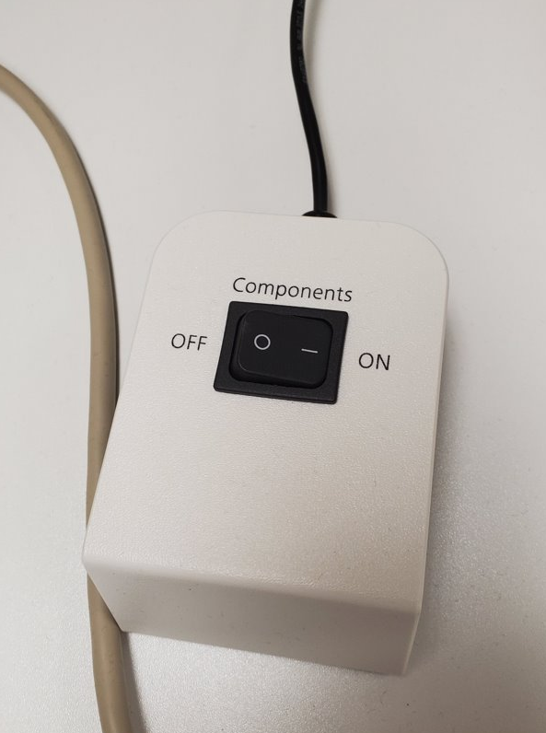
ELYRA 7 STARTUP PROCEDURE
ADVANCED IMAGING CORE
ELYRA 7 LS SUPER-RESOLUTION MICROSCOPE: EQUIPMENT BASICS
Main Switch (located on front of laser rack)
Components Switch (located on desk next to acquisition PC)
[Not Pictured] Turn on acquisition PC
1
2

Slide 20
ELYRA 7 SHUTDOWN PROCEDURE
ADVANCED IMAGING CORE
ELYRA 7 LS SUPER-RESOLUTION MICROSCOPE: EQUIPMENT BASICS

Slide 21
ELYRA 7 SHUTDOWN PROCEDURE
ADVANCED IMAGING CORE
ELYRA 7 LS SUPER-RESOLUTION MICROSCOPE: EQUIPMENT BASICS
POWER OFF: Reverse operation from turning the system on
SAVE ALL FILES
When closing Zen Black, be sure to switch all laser lines off
Shut down PC
Turn off Components switch
Wait about 5 minutes to let lasers cool down
Turn off Main Switch
Clean off objectives with lens paper and wipes provided
Clean off eye piece using 70% ethanol spray and paper towels provided

Slide 22
GENERAL SUGGESTIONS AND TIPS
ADVANCED IMAGING CORE
ELYRA 7 LS SUPER-RESOLUTION MICROSCOPE: EQUIPMENT BASICS

Slide 23
GENERAL SUGGESTIONS AND TIPS
ADVANCED IMAGING CORE
ELYRA 7 LS SUPER-RESOLUTION MICROSCOPE: EQUIPMENT BASICS
Always lower the objective before loading your sample!!!
Also, never assume that the previous user has left the objective at a safe distance.
The working distance (distance between the objective and your sample) will change between the different objectives, sample holder inserts, etc.
It may be difficult to see when the objective + oil touches your coverslip from directly above.
Zeiss recommends using coverglass 1.5H.
Please see the Zeiss sample prep guide on the core website for additional recommendations.

Slide 24
GENERAL SUGGESTIONS AND TIPS
ADVANCED IMAGING CORE
ELYRA 7 LS SUPER-RESOLUTION MICROSCOPE: EQUIPMENT BASICS
Save and close images throughout experiment, not just at the end.
Keep an eye on your system memory usage (through the Task Manager). Filling up the memory risks crashing the software and losing any unsaved files.
As this is an inverted microscope with a laser-safe box around it, it is virtually impossible to find specific regions within a large sample using a lower magnification objective and then switching to a higher magnification objective to find that same area.
The sample-holder insert must be removed each time the objective is changed, along with cleaning off all oil from the objective. Therefore, finding that precise area again is very difficult.
The 10x objective is a dry objective, the rest are oil objectives. The alpha 63x objective is for doing TIRF imaging. If performing TIRF imaging or SMLM, ensure that the alpha 63x objective is selected.

Slide 25
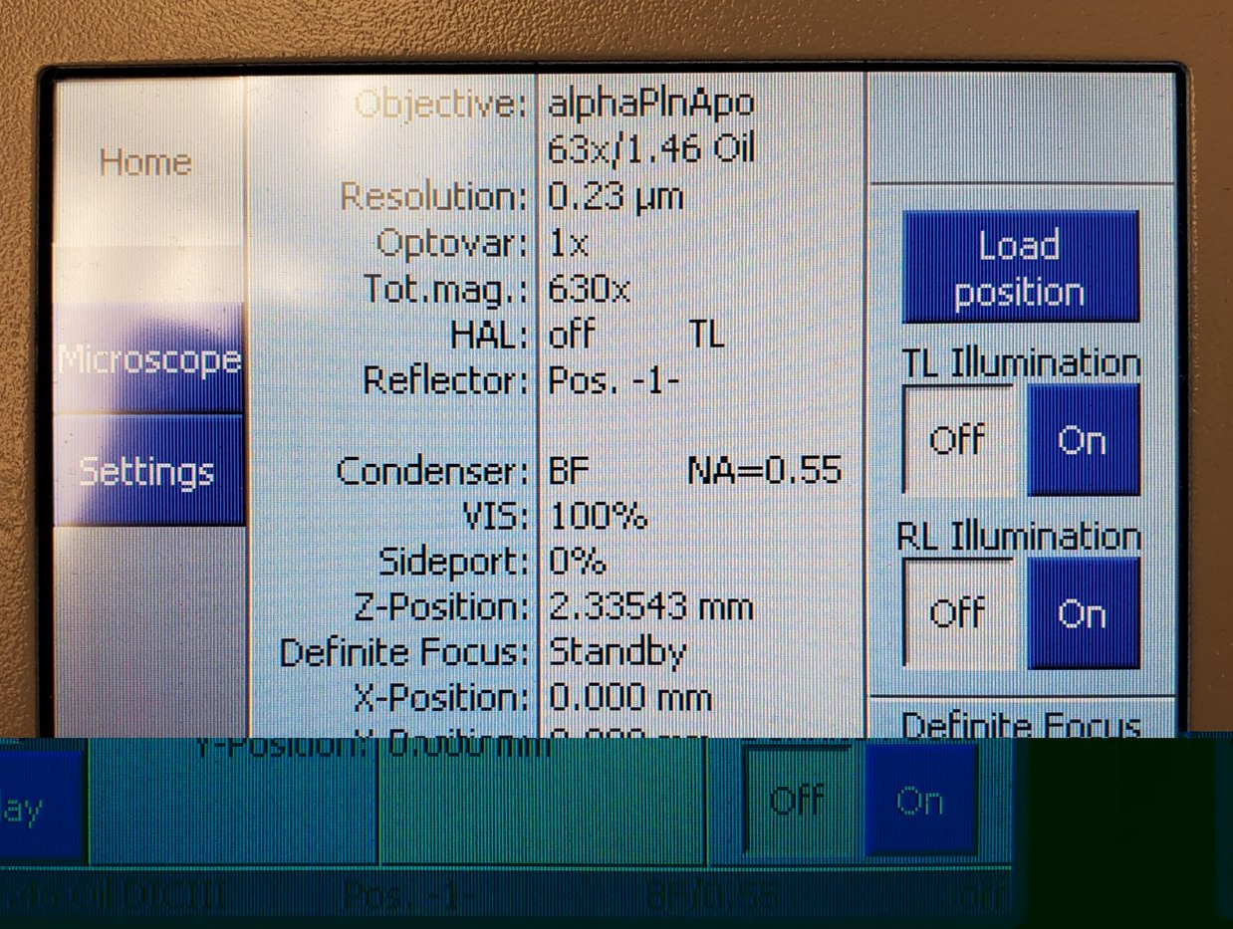
GENERAL SUGGESTIONS AND TIPS
ADVANCED IMAGING CORE
ELYRA 7 LS SUPER-RESOLUTION MICROSCOPE: EQUIPMENT BASICS
For all objective/sample combinations, the Z-position at which you will be in focus will be between 3-8mm (as listed by the microscope screen, NOT Zen black).

Slide 26
YOU ARE NOW READY TO TURN THAT BABY ON AND START ZEN BLACK!
ADVANCED IMAGING CORE
ELYRA 7 LS SUPER-RESOLUTION MICROSCOPE: EQUIPMENT BASICS

